Slide 1
Welcome to all our new Sapphire parents and returning Emerald and Ruby parents.
We are delighted you can join us this morning for coffee and our phonics workshop.

Slide 2
Phonics Workshop
14th September 2022

Slide 3
Government Guidance on the teaching of phonics 2022
The government has reviewed its guidance on the teaching of phonics and set criteria which phonics schemes have to adhere to.
By ensuring high-quality phonics teaching the government wants to improve literacy levels to:
give all children a solid base upon which to build as they progress through school
help children to develop the habit of reading widely and often, for both pleasure and information

Slide 4

We have chosen to use Rocket Phonics as our phonics scheme.
We felt this gave a good level of challenge and support for the children with engaging resources, to use both for home and school.
However this is a new scheme and as such the previous book band colours will not be used in KS1 in the same way. Your child may be on a different colour than before.

Slide 5
What will a phonics session include?
All children will have two 15 minutes sessions a day of phonics. This is likely to change to one session of 30 minutes for Year 2 children later in the year.
Day 1 – Blending focus (combining sounds to help children read)
Children will review previous sounds learnt and be taught a new sound through the online big books. Then they will practise and apply the new sound in individual pupil practise books, blending for reading.
Day 2 – Segmenting focus (Separating sounds so they can be identified)
Children will review sounds, be taught the letter formation for the sound then practise writing the sound and segmenting for spelling.
Day 3 & 4
This sequence is repeated with a new sound
Day 5
Review and consolidation. Common exception words teaching.

Slide 6
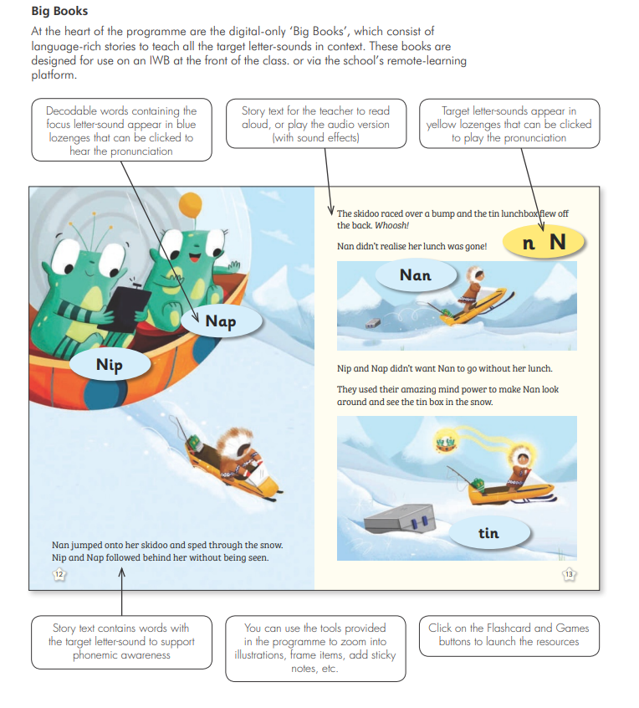
Big Books

Slide 7
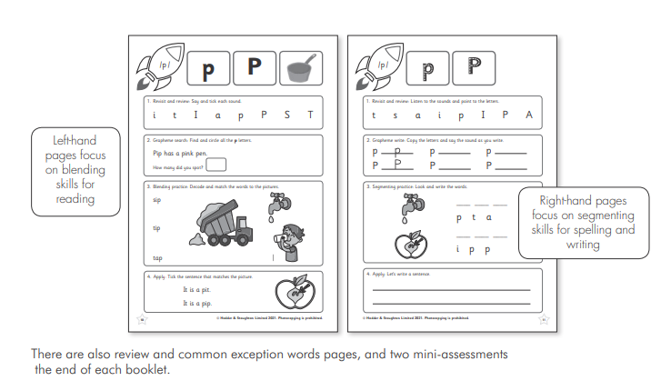
Pupil Practise Books

Slide 8
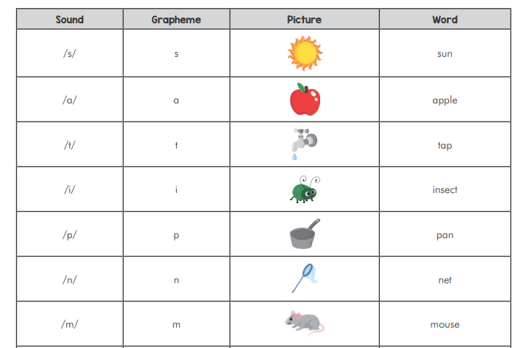
Mnemonics
A mnemonic system is a way of helping children to remember letter-sound correspondences.

Slide 9
Supporting your child’s reading at home
Reading Books
All children in Reception, Year 1 and Year 2 will receive two reading books a week (as well as a library book). These two books are to be read at home and will be returned and changed for a new book on a Friday.
As a parent you know your child best and how to engage them in their reading. This pattern may be helpful when they read to you.
Every time they read – Begin by looking at the pictures and help your child to explain the story then encourage your child to concentrate on the phonics sounds whilst reading.
Alternate these two ideas.
1) Focus on using a storyteller voice and developing fluency for the words read.
2) Ask your child questions about the story to develop their comprehension.

Slide 10
Supporting your child’s reading at home.
Children will only start to read books of a particular colour when all the sounds from that colour have been taught. For this reason the colours on the books will not necessarily match with what your child was reading last year.
To progress through the scheme, the assessments require the children to be able to both read and write the sounds, which is a change but we anticipate this will lead to the raising of standards.
Word Lists
Children in Year R and Year 1 will also have a ‘I can blend’ word list sent home each week.
Firstly children will blend the sounds to read, then parents can say a word from the list and the children will segment it and try to write down the word.

Slide 11
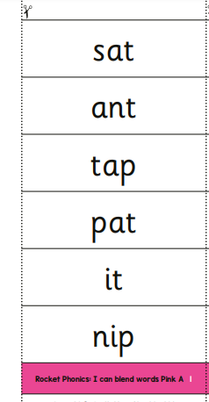
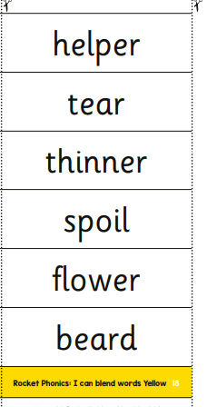
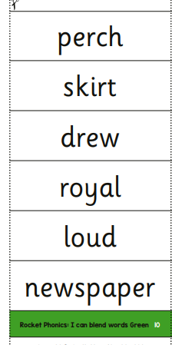
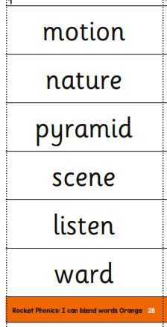

Slide 12
Supporting your child’s reading at home - Year 2
At the moment children in Year 2 will access their words through Spelling Shed and the list will be sent home. Please also continue to blend and segment these words with your children.
‘I can blend sheets’ will also come home for your reference.
The Year 2 expectations will be reviewed after Christmas as the majority of children will move to a new part of the phonics scheme.

Slide 13
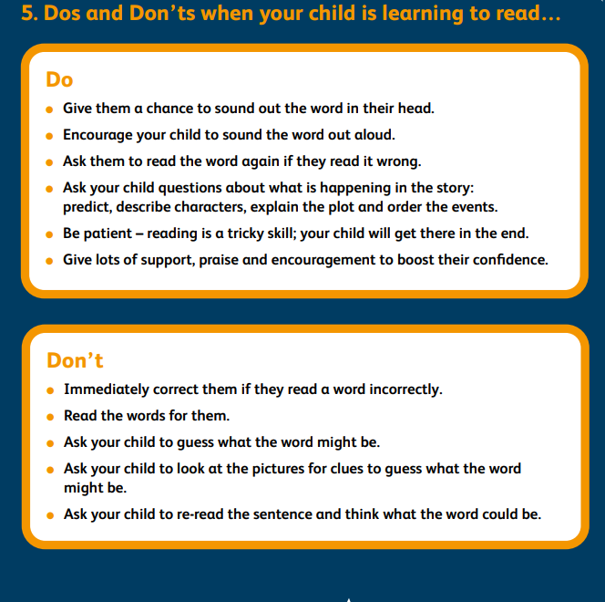
The most important thing is that you and your child have fun while they are reading or you are reading to them.
Here are some other suggestions.
Another top tip is to consider reading with your child in the morning as sometimes they are more willing to read!

Slide 14
Thank you very much for joining us today.
We will be sending out these slides, a more detailed letter about how to support your child as well as the Rocket Phonics parent guide.
Please do stay and ask any questions you would like to.

