Slide 1



Times tables at Thorpe

Slide 2
Fluency in multiplication and division facts.
Understanding of multiplicative relationships

Slide 3
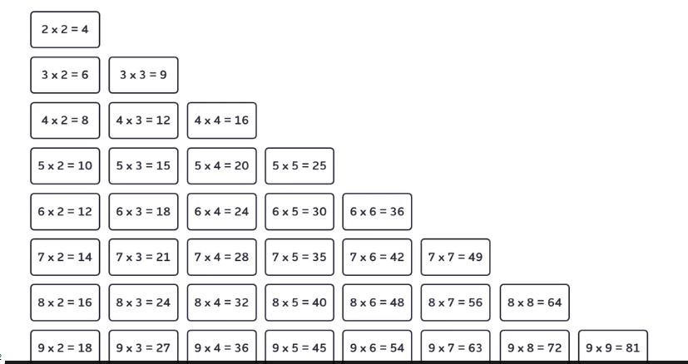
36 multiplication facts

Slide 4
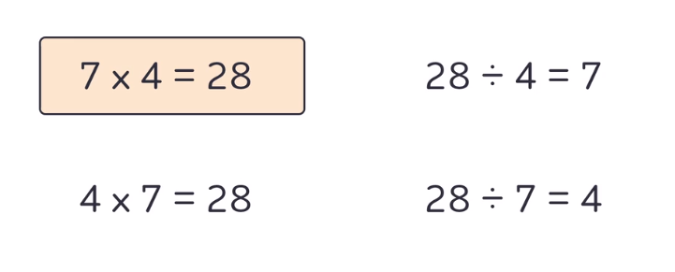
Commutative multiplication facts and inverse division facts

Slide 5
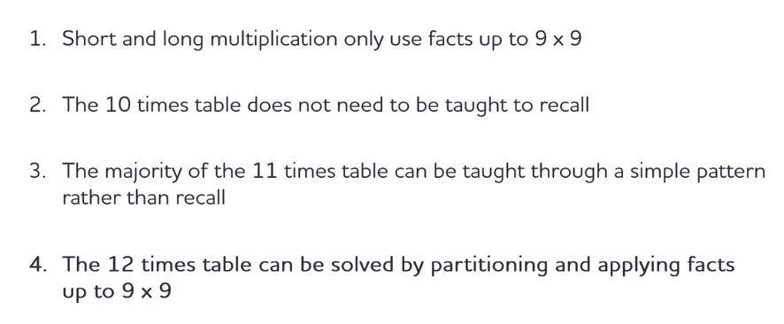
Why focus on the 36 facts?

Slide 6
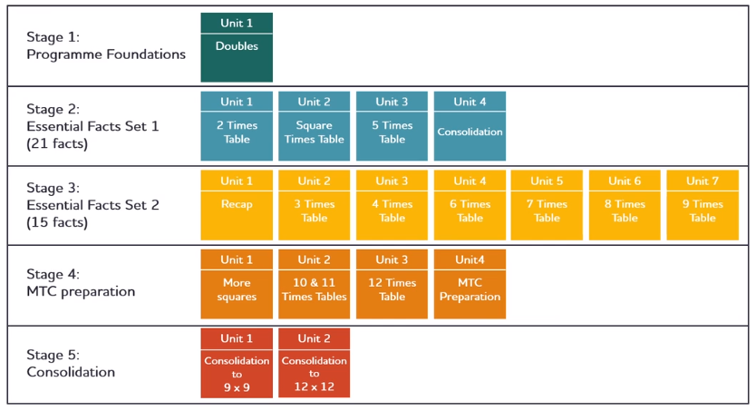

Slide 7
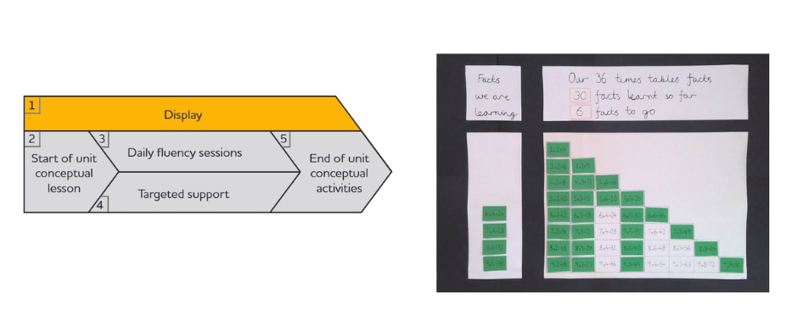
Daily lesson

Slide 8
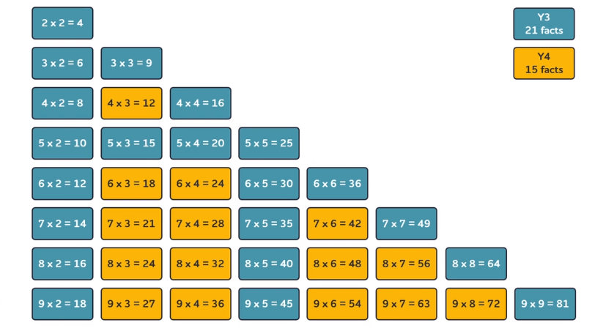
The 36 essential facts are taught across year 3 and 4

Slide 9
Thank you for listening.
Any questions?
How can you help at home ?
Chanting the facts they are learning together- these should be sent home when they change.
Use double sided cards- fact on one side, answer on the other- independent practice.
Matching games facts and answers – memory game, bingo

