Slide 1
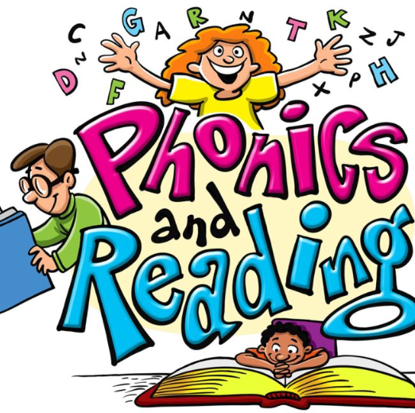
Welcome to
Ruby Class Phonics
Workshop

Slide 2
Aims
To support your understanding of phonics in Year 2
To share some of the terminology and teaching practices we use with the children
Guidance on how to help your child with their reading and spelling at home
To share a short reading activity with your child

Slide 3
New research on the benefits of reading (beyond academic success)
Children who read are more likely to be happier/healthier
Children who read are more likely to experience better mental well-being and self-esteem
Children who read are more likely to develop empathy and creativity
We need to read to and read with children and make time to talk about books.
(Book Trust March '23)

Slide 4
Phonics consists of:
Identifying sounds in spoken words
Blending phonemes (sounds) into words
Segmenting words into phonemes for spelling
Helping children to develop good reading and spelling skills
In year 2 the teaching of phonics consolidates Phase 4 and 5 sounds (phonemes) so the children become more fluent with reading and writing them. Often sounds will be represented by different spelling patterns (graphemes)
/ee/ can be written using the graphemes ee (bee), e-e (scene), ie (shield), ea (peach), y (happy), ey (key), e (me)

Slide 5
How to say the sounds
Saying the sounds correctly with your child is extremely important.
The way we say a sound may well be different from when you were at school.
We say the shortest form of the sounds. Sounds should be pronounced softly and in a clipped, short manner. Not with a ‘schwar’
Otherwise blending or spelling pin
e.g. pur- i –nur becomes very tricky!
So it’s p – i - n

Slide 6
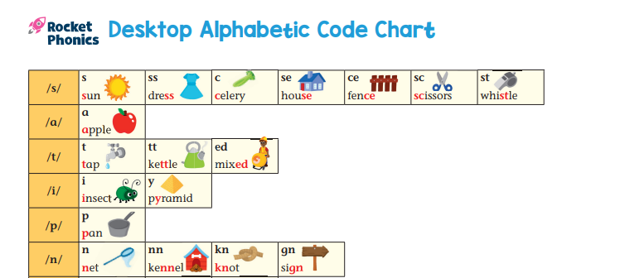
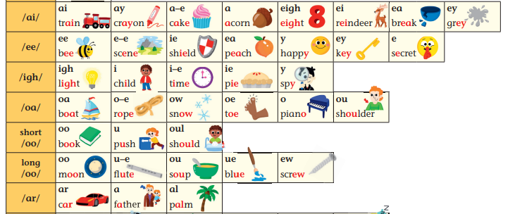

Some of the graphemes we teach in Year 2. We have this for you to take home.
We use a systematic synthetic scheme called ‘Rocket Phonics’.
Rocket phonics uses a mnemonic system to help children to remember letter-sound correspondences. E.g. ‘i as in child’

Slide 7
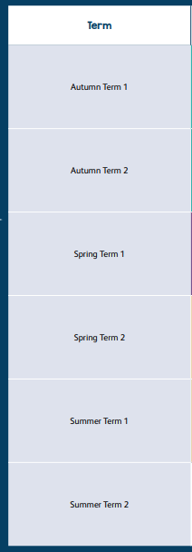
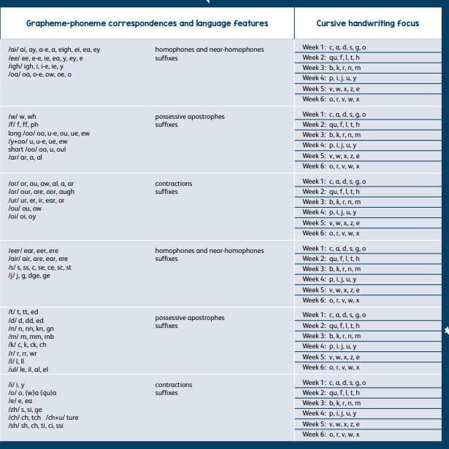
Sequence of graphemes

Slide 8
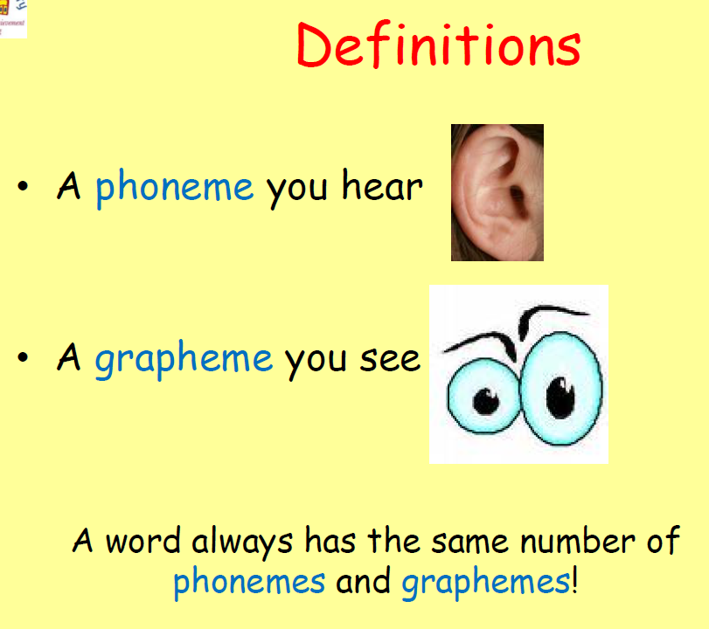
Blending for reading
First, children need to recognise the graphemes* in a written word
e.g. child
Then children need to blend them in the order in which they are written to pronounce the word ‘child’.
Children become code breakers and are able to decode unfamiliar words
*A grapheme – These are the letters that represent the phoneme (sound).
A grapheme you see

Slide 9

Segmenting for spelling
To spell a word, we need to be able to identify the individual sounds in the spoken word
E.g. rain → r-ai-n
Phonics Fingers
We use the left hand (palm facing) to count sounds from the thumb across the fingers to work out how many sounds can be heard in a word before attempting to write it.

Slide 10
Segmenting activity
Using phonics fingers, can you say how many phonemes are in each word?
cat
dress
sprint
Phoneme = sound
A phoneme you hear

Slide 11
How many phonemes are in each word?
cat = c – a – t = 3 phonemes
dress = d - r - e – ss = 4 phonemes
sprint = s – p – r – i – n –t = 6 phonemes
Phoneme = sound
A phoneme you hear

Slide 12
Supporting segmenting to write
In rocket phonics we use:
Phonics fingers
Phonics dashes
r
ai
n

Slide 13
Common Exception Words
Alongside the teaching of phonics, we cover Common Exception Words (CEWs). They are taught as whole words and need to be recognised by sight.
Many of these words are not phonetically decodable
e.g. was, the, I
•Some are ‘tricky’ to start with but will become decodable once they have learned the harder GPCs (Grapheme Phoneme Correspondences)
e.g. out, there

Slide 14
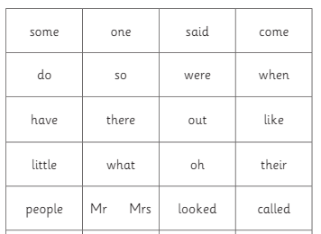
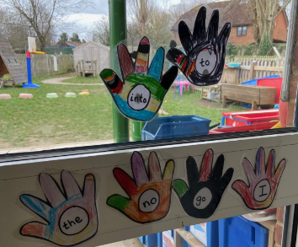
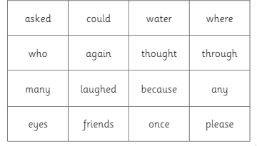
Something that often holds a child back from becoming a fluent reader, is their common exception words recognition. Please help your child become confident at reading all of these.
Year 1 Common Exception Words

Slide 15
How we teach:
Daily Phonics
15 minutes phonics input (Revise, teach, practise and apply)
15 minutes Pupil Practice Booklet
15 minutes paired reading
Extra phonics practice to consolidate and revise
Letter formation is taught as a specific lesson on a Friday.

Slide 16
Reading at home
Decoding, fluency and comprehension
All children will receive a reading book, access to several e-books per half term and a library book
The reading book needs to be read at home (many times) and returned to school on a Friday morning. Please ask your child to read and re-read the story over several days to develop their fluency.
Children read daily at school with a partner and within the week with a TA/CT
We suggest this pattern:
  1st reading - Look at the pictures and talk about what is happening
  2nd reading - Ask your child to read the book concentrating on the phonics/keywords on the inside front cover.
  3rd reading – Focus on using a storyteller voice and developing fluency for the words read.
  4th reading – Ask your child questions about the story to develop their comprehension.

Slide 17
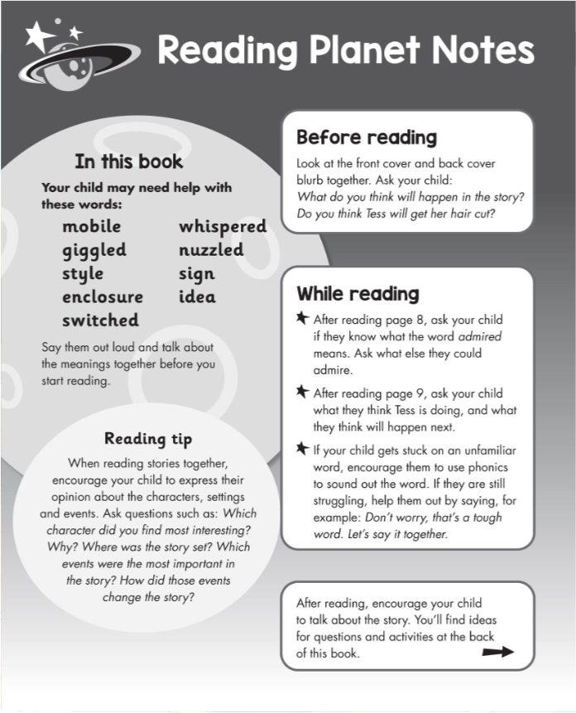
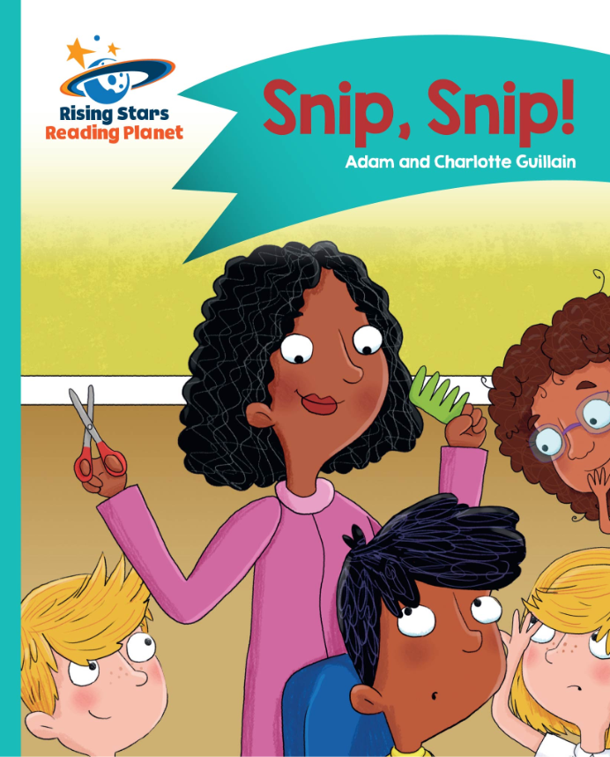

Slide 18
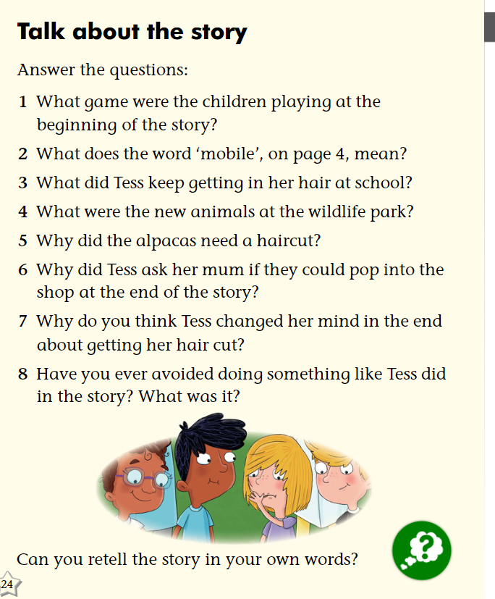

Slide 19
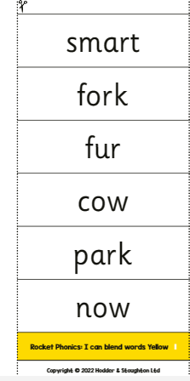
How can I help my child at home?
'I can blend' sheets will be sent home weekly. Please help your child to read and write the words to help consolidate the learning at home.
Once they have read them and are confident cover them and then dictate one.
Practise oral blending e.g. s-m-ar-t
My school uniform looks s-m-ar-t.

Slide 20
Please record in your child’s home school link book what they have read and do note if they are finding something tricky. i.e. 1st read – Joe looked at the pictures and was able to predict what they story might be about. ☺
2nd read – hairdresser √ scooted√
Joe needed help with glanced
3rd read – Joe re-read the story well and was able to sight read glanced.
4th read – We discussed the questions in the book and Joe retold the story in his own words.

Slide 21
Any questions?
Children will now join us to….

Slide 22
Ohio State University researchers found that young children whose parents frequently read to them could enter kindergarten having heard an estimated 1.4 million more words than children who were rarely or never read to (July 2019).
  'Reading and writing cannot be separated
  Reading is breathing in
  Writing is breathing out'
Thank you for coming today.
Your time and support is invaluable to helping your child succeed.

