Slide 1


Support for children and families in Runnymede – Summer 2024
Primary Mental Health Team

Slide 2
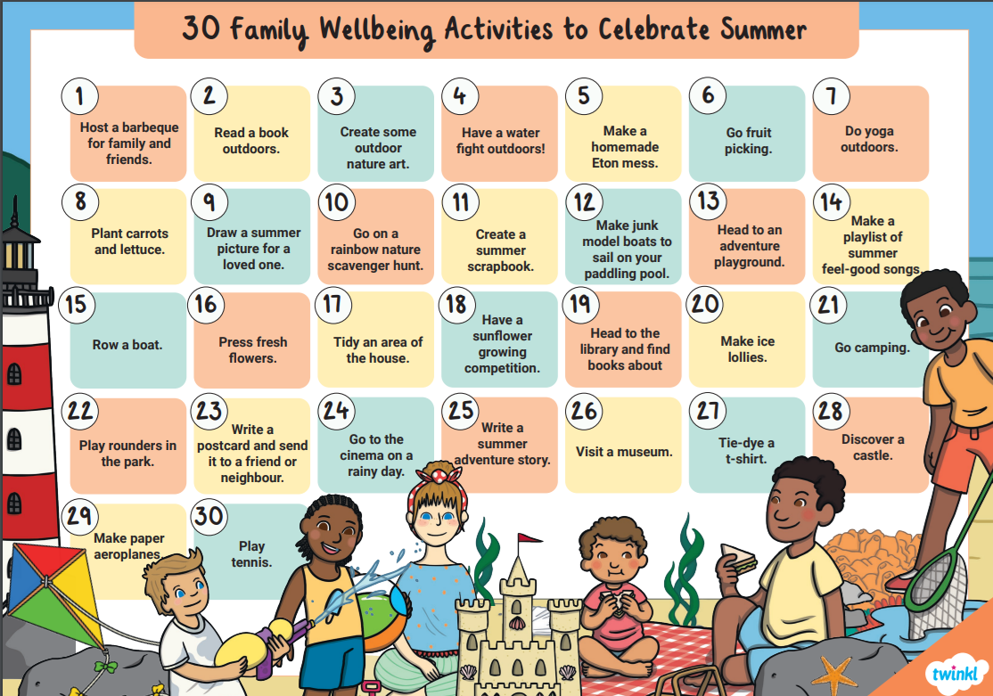
Inspiration for the whole family

Slide 3
Helpful tips for ASD and holidays:
Preparing for change: Think about the physical environment, how this will change; describe what will be involved on the day; could some things stay the same as lunch options?
Using visual supports: Look online for photos and on the website to show how it will look at the place and what you will do. Some museums have social stories that you can download.
Sensory sensitivities in the summer: Bring with you some tools to help with sensory overload, for ear defenders to block out noise.
Daily timetables: Write down a daily routine so that they know what is going to happen every day.
Sequencing: This can be difficult for an autistic person - that is, putting what is going to happen in a day in a logical order in their mind. Use a timer to help transition between activities. Use a now-and-next board, this can be very simple just a few post-it notes and pen. Use simple language – ‘then’ and ‘now’.
Be aware of anxiety: You could offer a worry book or box where they can write or draw any concerns they have. Explain the good things about the change, for example if you are going on holiday. Create a social story to explain what they could do if they are anxious. Consider using NAS Brain in hand autism support app. Take a comfort item with you to help with anxiety, for example weighted teddy bear – Website: https://www.barnfabrics.co.uk/cuddly-toys
Letting your holiday company know your requirements: For flights you can book special assistance and board beforehand so that your child will have a time to settle before the plain gets too noisy or busy.
Gatwick airport have a sensory room you can book before a flight to help with anxiety. See website: https://www.gatwickairport.com/passenger-guides/special-assistance.html
Autism alert cards: While on holiday, you may find it useful to carry an autism alert card that gives a brief explanation of autism. Get your Sunflower lanyard at: https://hdsunflower.com/

Slide 4

Out of Hours Service for Neurodiversity
Advice line for parents and carers of children and young people who have neurodevelopmental needs including Autism and ADHD.
Urgent support, advice or guidance available from 5pm-11pm, 365 days a year.
Tel: 0300 222 5755
Option 3: ASD Helpline
Option 4: ADHD Helpline
Website: https://www.mindworks-surrey.org

Slide 5

CYP HAVEN drop-in Centre
The CYP Haven is a safe space for children and young people aged 10-18 where you can talk about worries and mental health in a confidential, friendly and supportive environment.
It is based in four different locations around Surrey.
They offer virtual drop-ins!
You can also call them 6 days a week, Monday to Friday between 3.30pm and 7.30pm and Sunday 1-4pm
Tel: 01483 519436.
Website: https://www.cyphaven.net/

Slide 6
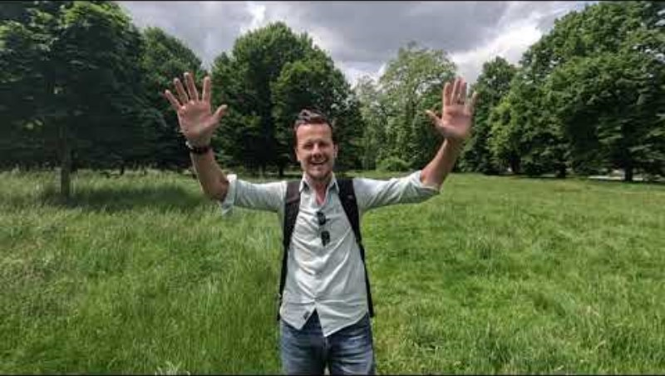
Summer of Love
Kindness Challenge
The Summer Kindness Challenge encourages children to spread kindness all summer long. Just download our calendar for children to record their acts of kindness. We have provided some ideas for them, but left plenty of space for them to come up with their own ideas. If you are already on summer break now, it is something that children can do when they return to school, as the deadline for completed calendars is 12th September. Watch Greig’s video for everything you need to know.
Watch Kindness Challenge video
Download your Kindness Calendar

Slide 7

Charity Book Stall!
Location: High Street, Egham, TW20 9EX (opposite Iceland/next to The Red Lion pub).
10,000+ New, Second-hand & Collectors Corner books, sorted by category/author, plus music items - at very competitive prices!
ADULT FICTION: New and Nearly New Fiction Books – all sorted by author
COLLECTORS CORNER: ~1,000 antiquarian books, maps, artwork
CHILDREN'S: A wide ranging selection of children's books
REFERENCE: A selection of good quality books in a variety of categories.

Slide 8

Free Big Nature Play Day!
On Saturday 3rd August 2024, from 2pm to 4pm, Runnymede Borough Council is hosting a FREE Big Nature Play Day with Nature Makers North Surrey.
Please book your free tickets at
https://www.nature-makers.co.uk/surrey-north

Slide 9
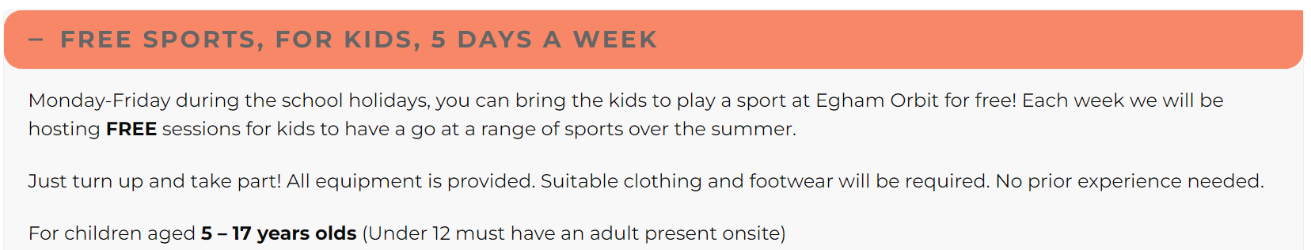
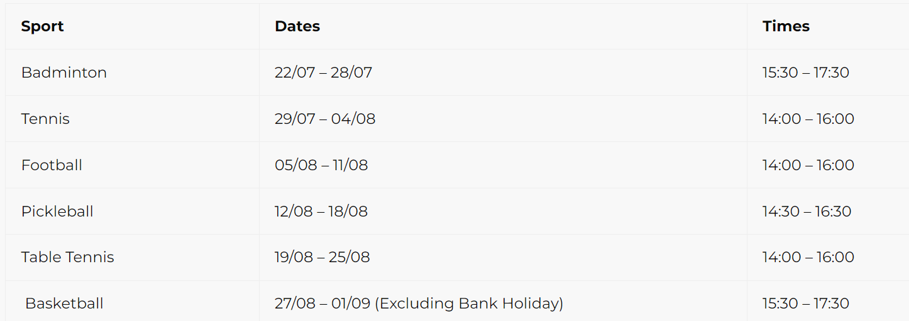
Free sports for kids

Slide 10
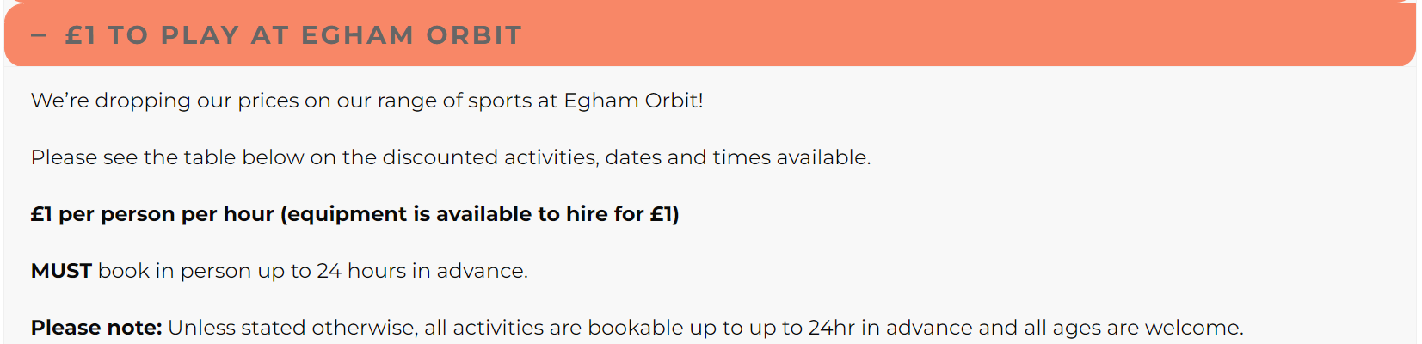
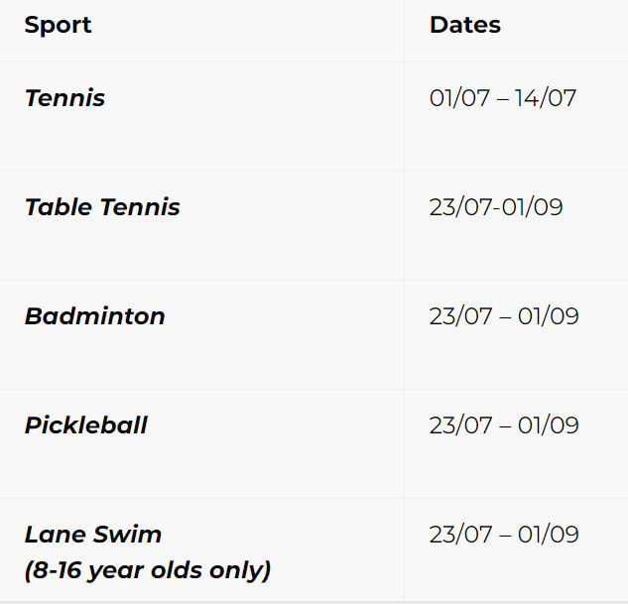
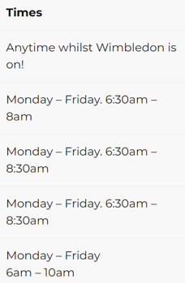
Kids can book the football pitch during the summer holidays for ONLY £10! and they can invite up to 9 friends! Only bookable in person or by calling 01784 333 111.
Only for under 16 year olds, weekdays during off peak hours. Maximum of 10 kids per pitch. Kids must check in at Reception prior to their booking.

Slide 11


Runnymede Sports Day!
Come along to our community sports day on the 4th August at the Egham Orbit Leisure Centre. From 10am-3pm all the family can take part in FREE mini challenges and taster sessions, plus food, drink and entertainment will be available!
Let us know your coming and you will be in with a chance of winning awesome prizes. For more information and to book visit our webpage here:
https://www.runnymede.gov.uk/get-fit.../runnymede-sports-day

Slide 12

Club 4
The Government has funded local authorities across England to run fully funded HAF (Holiday Activity & Food) camps for children who receive benefit-related free school meals.
These camps – known as ‘Club4’ in Surrey – run in the Easter, summer and Christmas holidays and offer healthy food and fun activities for eligible children aged 4-16.
Active Surrey are working with trusted and vetted activity providers to run the Club4 programme on behalf of Surrey County Council.
If your child is eligible for benefit-related free school meals, their school should automatically send you an Evoucher via email/text.
If you don't currently receive benefit-related free school meals but think you might be eligible, please click here.

Slide 13



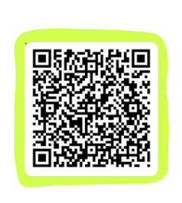

Combining sport and wellbeing!
Is your child at a loose end during the summer? Does your child live in runnymede, particularly the addlestone area? Would your child benefit from keeping active through sport?
Learn more about an exciting program launching this Summer that helps young people develop their emotional wellbeing while keeping active and taking part in playing sport! For ages 8-16. Younger group - 8-11 Older - 12-16

Slide 14
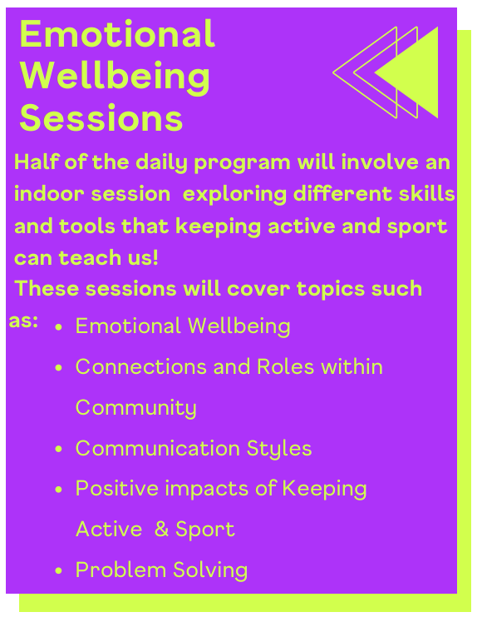
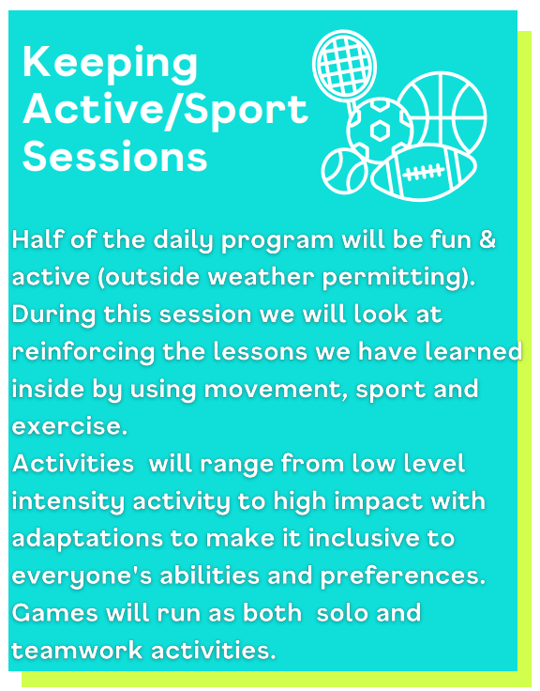


Sessions will be divided by indoor and outdoor activities
If you have any questions or are interested, email RBC@eikon.org.uk or follow the QR code

Slide 15






Runnymede - Family Centre
Groups and Courses at Runnymede : Surrey Barnardos Family Centres (barnardosfamilycentressurrey.org.uk)
The DICE programme aims to raise parental awareness of child exploitation by increasing the knowledge and understanding of the
issue that seems to affect so many children and young people in our society.
Our Parent Drop-in is a weekly session where you can pop in to speak confidentially to a Family Support Worker for support on all aspects of family life. Domestic Abuse support and guidance is also available at this session.
Parenting Puzzle is our 10 week evidenced based parenting course
Keeping Your Child in Mind is a 4 week parenting course to support parents to communicate more efficiently and work together to support their family.

Slide 16

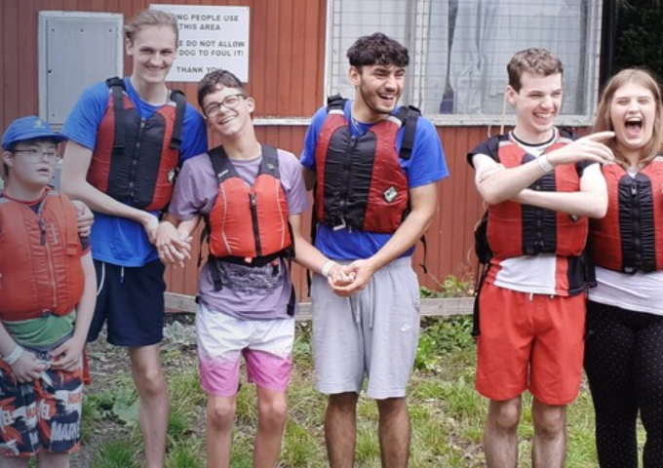
Next Steps Holiday Schemes
A fun programme of activities to support young people during the holidays.
These sessions are inclusive and for everyone no matter their needs or disability. With a range of onsite and offsite activities, there is something to engage everyone.
Next Steps holiday schemes provide opportunities for teens to grow their independence and build friendships.
Onsite you can expect a mix of fun activities like arts and crafts, baking, discos, sensory activities, movies, visits from therapy dogs and crocodile encounters (!) and more.
Offsite activities can be anything from bowling, laser quest, lunch out, visits to the park, picnics, cinema, trampoline parks, minigolf, farms and more.
To attend our holiday schemes, you need to be registered with LinkAble. Costs £30 per session.
See website: https://www.linkable.org.uk/pages/next-steps-holiday-schemes

Slide 17

Museum Makes - Free Family craft activity
Date: 3 Aug 2024 join Museum makes on the 1st Saturday of the month - 1:30pm to 3:30pm for a fun family craft activity where imagination meets history in a hands-on experience for all ages!
FREE DROP IN SESSION
Website: https://www.chertseymuseum.org.uk/?location_id=149&item=1507&itemoffset=

Slide 18

Elysian Summer Events
They are running a range of sessions across summer such as:
Neurodiverse Play Sessions
Tackling Anxiety Workshop
Self Esteem Sessions
Art on the Farm
Pony Play
Location:
    Westland Farm,
    Shamley Green,
    Guildford,
    GU5 0TL
Tel: 07944 875155
Website: https://elysianuk.org/

Slide 19

Surrey Fire and Rescue open days and events
Fire Stations across the county regularly open their doors to the public. This gives Surrey residents an insight into the activities of their local fire station.
These events are a great opportunity to see the range of activities involved with being a modern firefighter, to learn about our crews, see our fire engines, and learn about fire safety!
Guildford Fire Station - Saturday 3 August. 10am to 11am (Special Educational Needs) 11am to 4pm All
Website: https://www.surreycc.gov.uk/community/fire-and-rescue/fire-stations-and-events/open-days#fireopenday

Slide 20


REGISTER YOUR INTEREST HERE

Slide 21

REGISTER YOUR INTEREST HERE

Slide 22

REGISTER YOUR INTEREST HERE

Slide 23

Foodbank - Runnymede
Foodbank centres are open to the public according to the following schedule:
Egham centre on Mondays from 10:00 - 12:00 (except closed on all Bank holidays)
Addlestone Baptist Church centre on Tuesdays from 10:00 - 12:00
St Pauls Egham Hythe centre on Tuesdays from 19:00 - 20:30
Chertsey centre on Wednesdays from 10:00 - 12:00
Englefield Green centre on Wednesdays from 13:00-15:00
Addlestone Baptist Church centre on Thursdays from 10:00 - 12:00
Weybridge centre on Thursdays from 13:00 - 15:00
King's Church centre on Fridays from 10:00 - 12:00 (except closed on all Bank holidays)
Website: Locations | Runnymede Foodbank

Slide 24


Green hub
The Green Hub Project for Teens is a local community charity serving residents of Godalming, Milford and Witley, along with the broader Waverley and Surrey areas. We support teenagers and their families / carers facing SEMH (Social, Emotional and Mental Health) challenges.
Our weekly Green Teens programme offers social and therapeutic gardening to stressed, anxious and neuro-diverse teens, giving them the chance to experience the calming effect of nature, benefiting their mental wellbeing. The programme runs FOUR FREE session options across our TWO locations,
Our Teen Talks team deliver empowering talks to teens, helping them to develop the life skills to help them develop resilience and strategies to handles life’s challenges – public courses and in schools.
Our FREE Life Skills for Teens programme is an 8-week online course to support teens with their mental wellbeing; launched in February 2024, it has already been followed by 100 local teens.
We deliver valuable FREE resources and advice to parents and teens, via our website Online Help.
Each month we run TWO sessions: Parent Hub and Parent Hub Online, to help parents supporting a child with SEMH challenges.

Slide 25

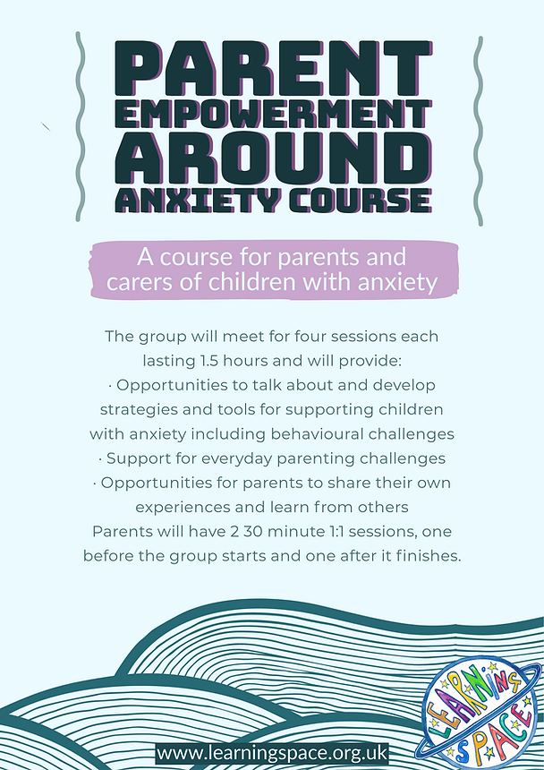

Parent Groups | Learning Space

Slide 26

Book of the Month
Happy, Healthy Minds by The School of Life, Lizzie Stewart.
Linked to the theme of Inside Out 2, this book helps you become more aware of your feelings.
It looks at a range of situations that might feel tricky, and helps you think about how to deal with them.

Slide 27
Finding online and phone support
Family Lives
  Helpline: 0808 800 2222.
  This service offers a 24-hour helpline, extensive advice on its website, live chat services, befriending services, and parenting/relationship support groups.
  Website: www.familylives.org.uk
Young Minds
  Helpline: 0808 802 5544
  A helpline and webchat service for parents and carers who are concerned about their child's mental health up to the age of 25. Open 9.30am - 4pm, Monday to Friday.
  Website: http://www.youngminds.org.uk/for_parents
IF URGENT MEDICAL ATTENTION IS NEEDED OR IF YOU FEEL UNABLE TO KEEP YOUR CHILD SAFE FROM THEMSELVES OR OTHERS, PLEASE PHONE 111 OR GO TO YOUR NEAREST A&E DEPARTMENT.
Kooth.com is an online service for young people aged 11-18 in Surrey that provides free and confidential counselling services via webchat provided by qualified counsellors.
Website: https://www.kooth.com
Childline: 0800 1111 (24 hours 7 days a week). Childline is the UK’s free helpline for children and young people. It provides confidential telephone counselling service for any child with a problem. It comforts, advises and protects.
Website: www.childline.org.uk

Slide 28
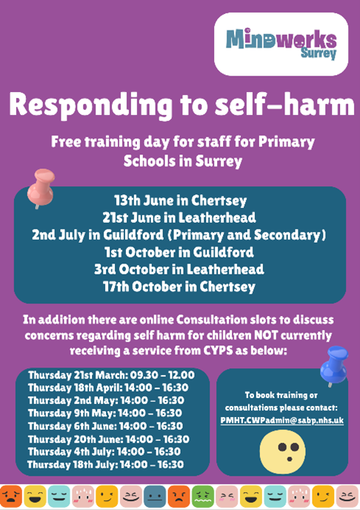

SELF-HARM

Slide 29

Coming soon - Runnymede Junior Ranger Programme
Thanks to funding from Runnymede Borough Council we're launching a brand new Junior Ranger Programme for young people aged 13 - 15 years. For anyone interested in careers in agriculture, the environment, the outdoors, sports, leisure and tourism, this programme is a great wait gain valuable work experience and learn practical conservation skills. Applications for this opportunity open on 1 September. Follow the link below for more information and register your interest.
https://forms.office.com/e/WEJdw7XZRT
For more info visit Junior Ranger Programme | National Trust

