Slide 1
Welcome to Ruby Class!
Mrs George – Class Teacher (Monday and Tuesday)
Mrs Graham – Class Teacher (Wednesday ,Thursday and Friday)
Mrs Mellor – Teaching Assistant (Monday, Tuesday, Wednesday)
Mrs Wade – Teaching Assistant (Thursday, Friday)
Miss Ives and Mrs McGranaghan - SNAs

Slide 2

School Day
8.40: Doors open
8.45: Registration
8.50: Phonics
9.30: English
10.30: Break
10.45: Collective worship
11.00: Maths
12.00: Mastering Number
12.15: Lunch
1.15: Foundation Subject
2.15: Afternoon snack
2.20 : Paired Reading/Foundation Subject
3.00: Story
3.15: Home time

Slide 3

The Curriculum
English
  Rocket Phonics
  Reading
  Writing
  Spelling, Grammar and Punctuation
  Handwriting (Phonics)
Mathematics
  Arithmetic and Fluency
  Reasoning
  Topic – Science, RE, History, Geography,
PSHE, Art, D&T, Music, PE, Computing

Slide 4
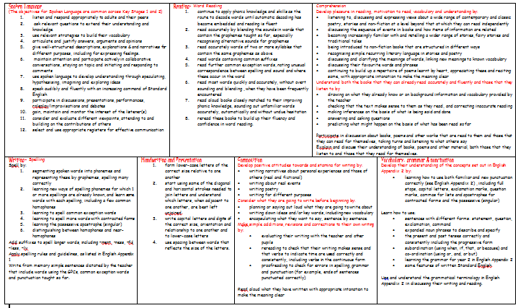

English
English National Curriculum
Daily Phonics Lessons (Rocket Phonics)
Paired Reading
Daily English lessons
Range of genres
Stories: Traction Man, Prince Cinders, The Tunnel
Non-fiction: Life Cycles, Riddles, Persuasive Letters
Poetry

Slide 5
Reading at Home
How can you help your child in English?
Encourage your child to read for pleasure – fiction, non-fiction, poetry
Be a good role model – echo reading, take it in turns
Little and often
Re-read a book more than once
1st read = Look at the pictures and talk about what is happening​
2nd read = Ask your child to read the book concentrating on the phonics on the inside front cover.​
3rd read = Focus on using a storyteller voice and developing fluency for the words read. ​
4th read = Ask your child questions about the story to develop their comprehension. ​
Please write a comment in your child’s home-school link book if you have heard your child read at home.
Sticker– read at least four times each week

Slide 6
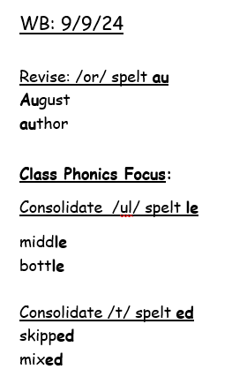
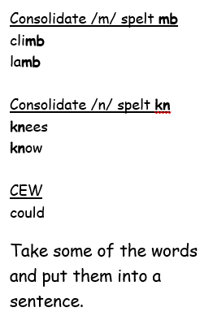
How can you help your child in English?
Practise phonics: Words linked to the focus phonics for the week are sent home every Tuesday. Please help your child to embed the sounds and write words containing the sounds within sentences.
Children are to hand these books back in on a Monday.
Also please practise reading and writing the Year 1 and 2 CEW. This will support their reading and writing fluency.

Slide 7

I Can Blend

Slide 8
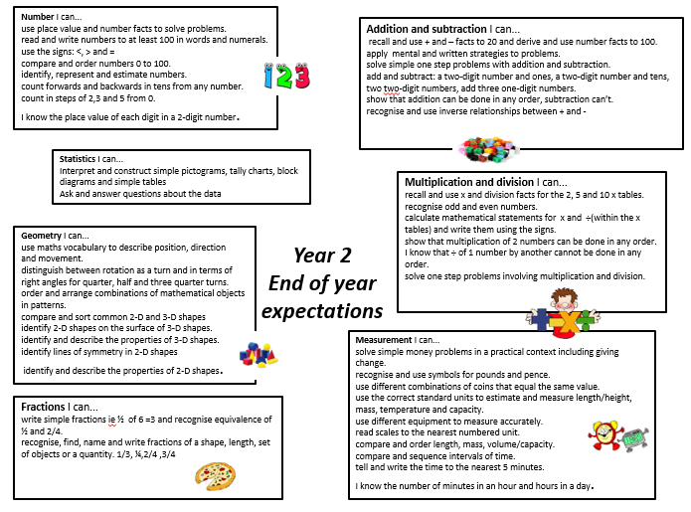

Maths
Daily maths lessons
Arithmetic
Fluency
Reasoning and Problem Solving
Morning maths (retrieval)
Mastering Number
How can you help your child in Maths?
Counting in 2s, 3s, 5s and 10s – forwards e.g., 0, 2, 4, 6, 8, 10 up to 20 and then 20, 18, 16, 14 etc.
Tell the time on an analogue clock (o’clock, half past, quarter past and quarter to). Once they are secure with these then they can go onto telling the time to the nearest 5 minutes.
Understand the value of each coin. How can you make 23p? What can I buy for £1? How much change will I get from…?
Measuring weight, length and capacity
Problem solving – e.g. I want to buy 20 cakes. There are 5 cakes in each box, how many boxes do I need to buy altogether? Max gets £2 pocket each week. How much money will he have after 6 weeks?
Maths games on MathsShed and White Rose 1 Minute maths app.
Digit Games – every other Friday

Slide 9
Curriculum
Science – Growth and Survival, Materials, Super Scientists, Plants
RE – We follow the Guildford Diocese Curriculum
3 Christianity topics
2 Islam topics
Thematic Unit – Giving and Receiving
Topic
Marvellous Me - Thorpe
Remember Remember – Fireworks and Great Fire of London
Once upon a time – Cinderella and Prince Cinders, How to trap a dragon
Amazing Animals - Habitats
What a wonderful world! – Africa (Sierra Leone)
Growth and Movement - Plants and Transport
Trips – Brooklands Museum and Africa Day

Slide 10

Rewards
Golden Rules/Class Rules – marble in a jar
Golden Time
Team points – work in books
Stickers for frequent reading

Slide 11

Home Learning
In addition to the reading, phonics and Maths mentioned, children will also receive …
Topic based Home Learning
Children will have a choice of 6 activities every half term. We ask them to complete at least one but they can do more if they wish.
Marvellous Me
Each Friday a child will have the opportunity to bring in a special item from home that they can share with the class. Please return the bag by Friday so other children get their turn.

Slide 12

Pride in our Uniform
Wearing the correct uniform to school is important. Please support us in ensuring your child comes to school wearing their uniform in a smart way.
No earrings on PE days
Children to wear PE kits on Mondays and Wednesdays.
Foundation Stage and Infant (age 4 - 7) Reception Year, Year 1 and Year 2
Girls | Boys
Yellow polo tops with school logo
Grey trousers or shorts
Grey skirts or pinafore dresses
Summer dresses blue and white check*
Sweatshirts/cardigans royal blue
Socks black , grey or white
Tights grey, black or royal blue
Black shoes
P.E Uniform
Yellow T-shirts with school logo Royal Blue Tracksuit Trousers Navy shorts Black/Navy leggings Trainers or Black Plimsols

Slide 13

Useful information
Snacks: We are a healthy eating school
Morning snack – please label snack pot (Fruit and Vegetables if possible)
Fruit/ Vegetables - provided every afternoon or children are welcome to bring extra in their snack boxes
Water only – please label
Milk (for those who sign-up)
Book bags (Home-School Link Book in everyday)
Clubs - To be confirmed. Earlybirds will run from 7.30am and Owls club from 3 – 6pm. ​

Slide 14
Finally
Please feel free to discuss any aspect of your child’s learning with us. Working together we can make the transition as smooth as possible. ​
Any Questions?

