Slide 1
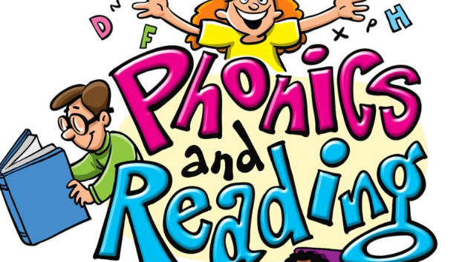
Welcome to
Sapphire Class Phonics Workshop

Slide 2
Aims
To support your understanding of phonics
To share some of the terminology and teaching practices we use with the children
For you to know how to help your child with their reading and spelling at home

Slide 3
Why teach phonics?
The ability to read and write well is a vital skill for all children, paving the way for an enjoyable and successful school experience.
Phonics helps children to develop good reading and spelling skills
The first phase of phonics would have started at nursery and preschool. Phase 1 concentrates on developing children’s speaking and listening skills and lays the foundations for their phonics in school. This includes:
Listening for environmental sounds
Rhythm and rhyme (including syllables)
Alliteration
Oral blending and segmenting
Notes:
Rocket Phonics is a fully resourced, systematic synthetic phonics programme that provides you with everything you need to teach children to read and write.

Slide 4

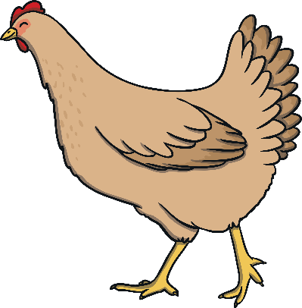








Find the rhymes
Notes:
Rocket Phonics is a fully resourced, systematic synthetic phonics programme that provides you with everything you need to teach children to read and write.

Slide 5




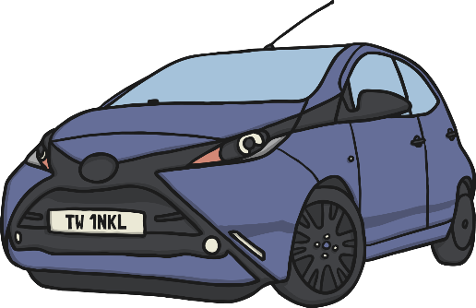



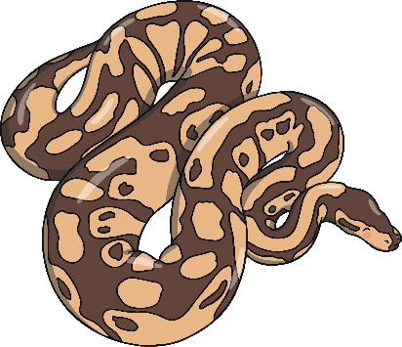
Initial sounds
What begins with the sound ______?
Notes:
Rocket Phonics is a fully resourced, systematic synthetic phonics programme that provides you with everything you need to teach children to read and write.

Slide 6
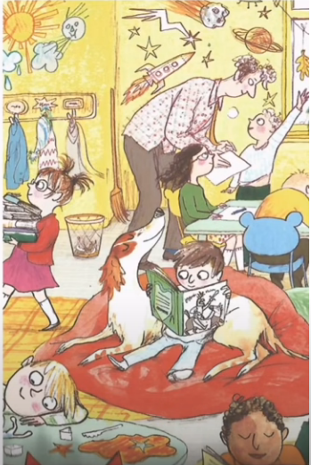

Books are full of many learning opportunities!
I can see the s-u-n
I can see the b-oo-k

Slide 7

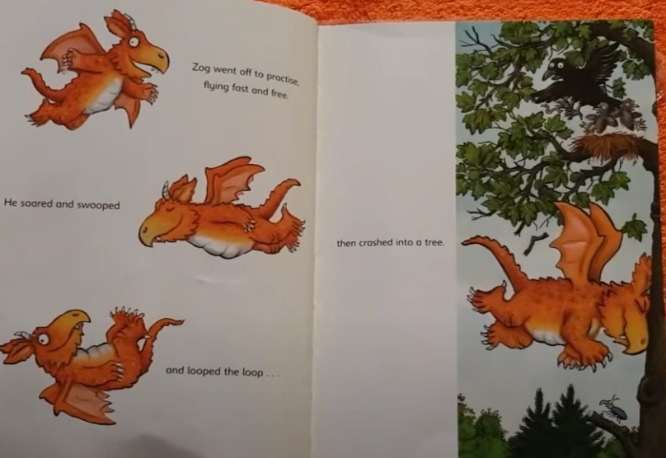
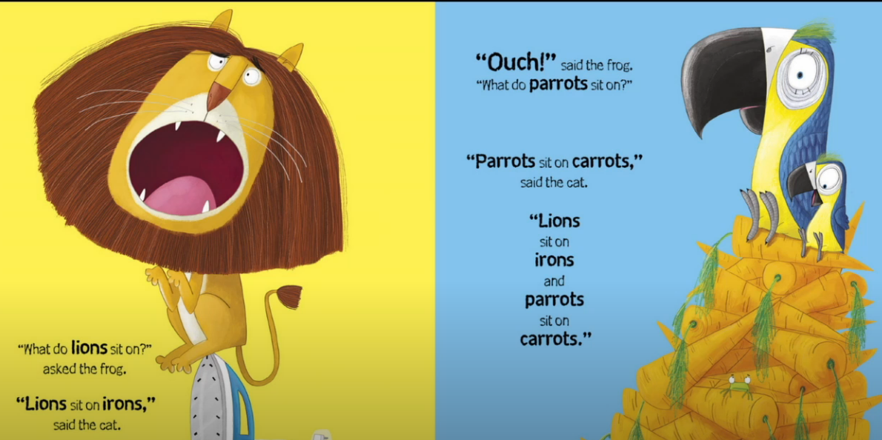

Rhyming with picture books

Slide 8

Being read to is the most powerful predictor of a child’s future reading comprehension.

Slide 9
Phonics consists of:
Identifying sounds in spoken words
Blending phonemes (sounds) into words for reading.
Segmenting words into phonemes for spelling.

Slide 10
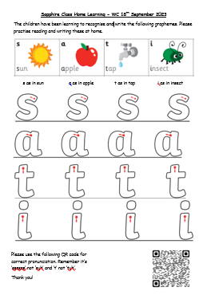
How to say the sounds
Saying the sounds correctly with your child is extremely important.
The way we say a sound may well be different from when you were at school.
We say the shortest form of the sounds. Sounds should be pronounced softly and in a clipped, short manner. Not with a ‘schwar’
Otherwise blending or spelling cat
e.g. cur- a –tur becomes very tricky!
So it’s c – a - t
Please use the QR codes on home learning sheets for link to correct pronunciation of sounds

Slide 11
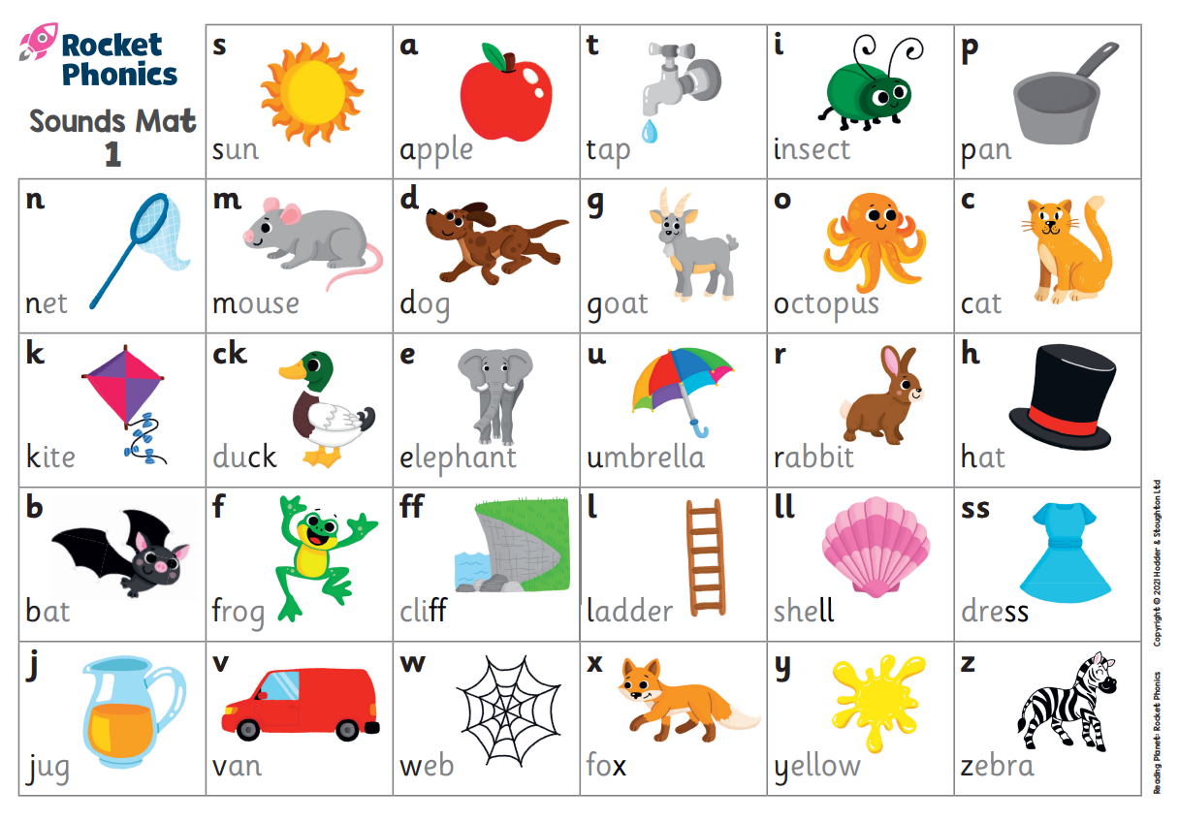

Graphemes we teach in Reception
We use a systematic synthetic scheme called ‘Rocket Phonics’.
Rocket phonics uses a mnemonic system to help children to remember letter-sound correspondences. E.g. ‘m as in mouse’

Slide 12
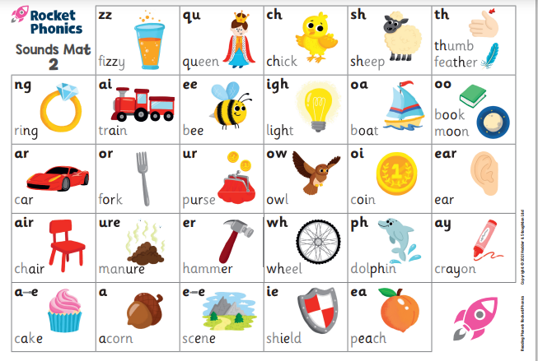
Graphemes we teach in Reception

Slide 13
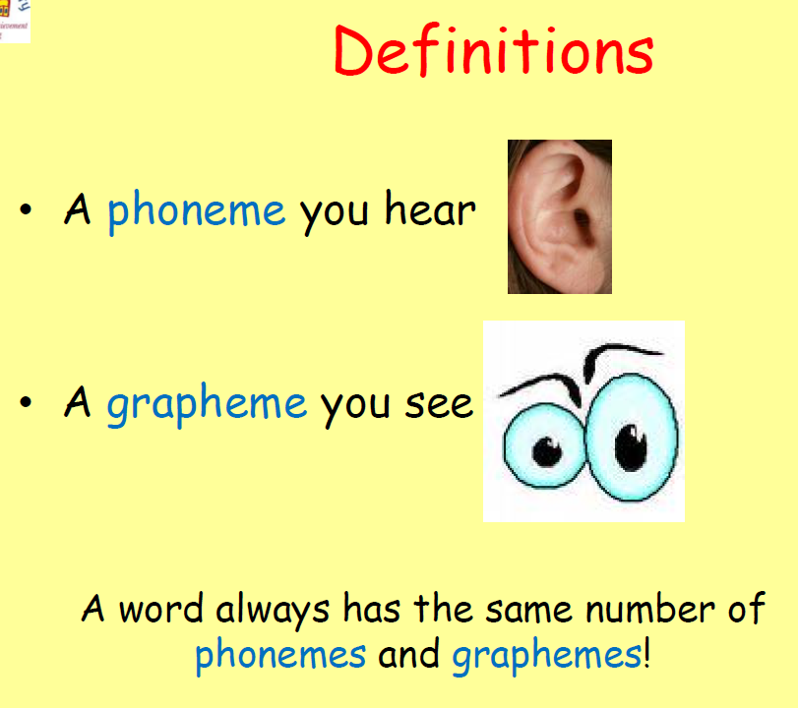
Blending for reading
First children need to recognise the graphemes* in a written word
e.g. cup
Then children need to blend them in the order in which they are written to pronounce the word ‘cup’
*A grapheme – These are the letters that represent the phoneme (sound).
A grapheme you see

Slide 14
c u p
Encourage your child to point under each grapheme (c-u-p)
Then swipe underneath to blend.

Slide 15

Segmenting for spelling
To spell a word, we need to be able to identify the individual sounds in the spoken word
E.g. dog → d-o-g
Phonics Fingers
We use the left hand (palm facing) to tally sounds from the thumb across the fingers to work out how many sounds can be heard in a word before attempting to write it.

Slide 16
Segmenting activity
Using phonics fingers, can you say how many phonemes are in each word?
cat
dress
sprint
Phoneme = sound
A phoneme you hear

Slide 17
How many phonemes are in each word?
cat = c – a – t = 3 phonemes
dress = d - r - e – ss = 4 phonemes
sprint = s – p – r – i – n –t = 6 phonemes
Phoneme = sound
A phoneme you hear

Slide 18
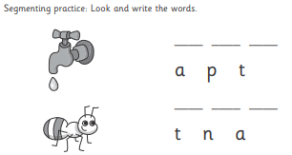
Supporting segmenting to write
In rocket phonics we use:
Phonics fingers
Phonics dashes

Slide 19
Common Exception Words
Alongside the teaching of phonics, we cover Common Exception Words (CEWs). They are taught as whole words and need to be recognised by sight.
Many of these words are not phonically decodable
e.g. was, the, I
•Some are ‘tricky’ to start with but will become decodable once they have learned the harder GPCs (Grapheme Phoneme Correspondences)
e.g. out, there

Slide 20
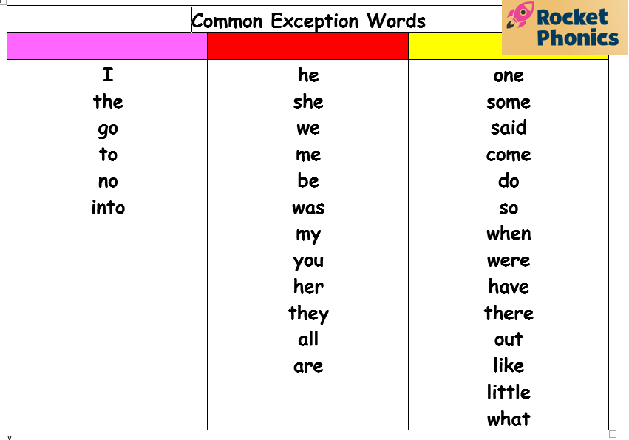
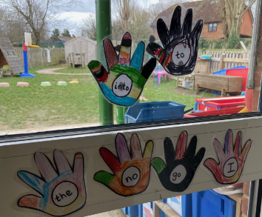
Something that often holds a child back from becoming a fluent reader, is their common exception words recognition. Please help your child become confident at reading these: I, the, to, go, no, into

Slide 21

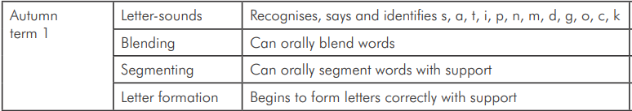
Autumn 1
Our aim is for children to be able to do the following by the end of Autumn 1.

Slide 22
Daily Phonics
15 minutes phonics input (Revise, teach, practise and apply)
15 minutes Pupil Practice Booklet
15 minutes paired reading
Extra phonics practice to consolidate and revise
Short oral blending session daily
Letter formation is taught at the same time when introducing each grapheme

Slide 23
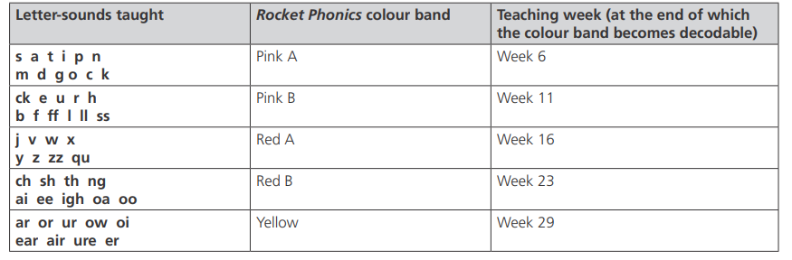
Order of sounds taught in Reception
Every week we teach:
2 sounds (graphemes)
1 or 2 Common Exception Words
At the end of each unit, we assess the children to see if they can use and apply the sounds taught in their reading and writing.
If they are confident with a set of sounds, they can then move onto the next reading book band (as long as all the sounds in the next set have been taught).
Notes:
We follow a clear pathway through the alphabetic code.

Slide 24
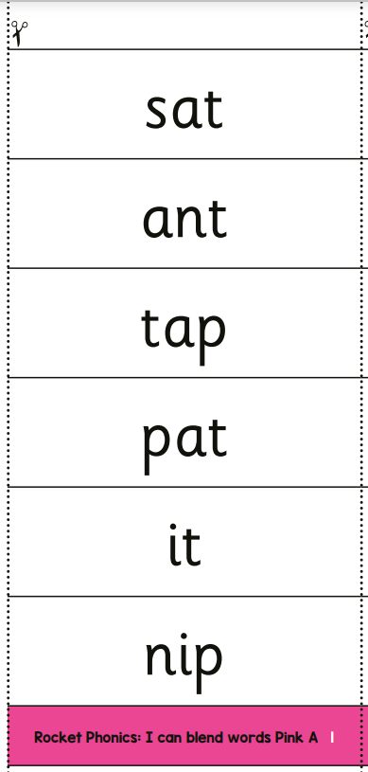
How can I help my child at home?
'I can blend' sheets will be sent home weekly. Please help your child to read and write the words to help consolidate the learning at home.
We will also be sending home common exception word hands for children to colour in and stick up at home to help them learn the words. These words need to be learnt by sight.
Practise oral blending e.g. b-o-x
I went to the farm and I saw a sh-ee-p. (one syllable words)

Slide 25
Reading at home
Decoding, fluency and comprehension
Once we have covered the first set of sounds (satipnmdgock) we will assess each child. If they can recognise and blend words with these sounds in, they will start reading Pink A.
All children in Reception will receive a reading book and a library book
The reading book needs to be read at home and needs to be returned to school on a Thursday. Please ask your child to read and re-read the story over several days to develop their fluency.
We suggest this pattern:
  1st reading - Look at the pictures and talk about what is happening
  2nd reading - Ask your child to read the book concentrating on the phonics
  3rd reading – Focus on using a storyteller voice and developing fluency for the words read.
  4th reading – Ask your child questions about the story to develop their comprehension.

Slide 26
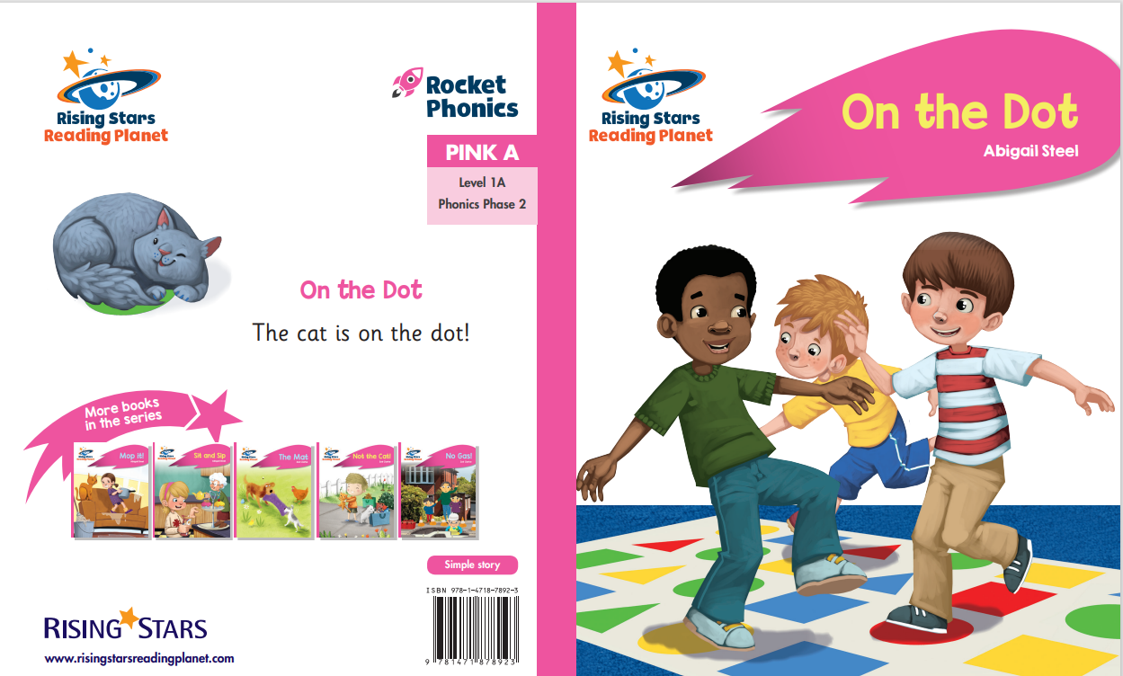

Slide 27
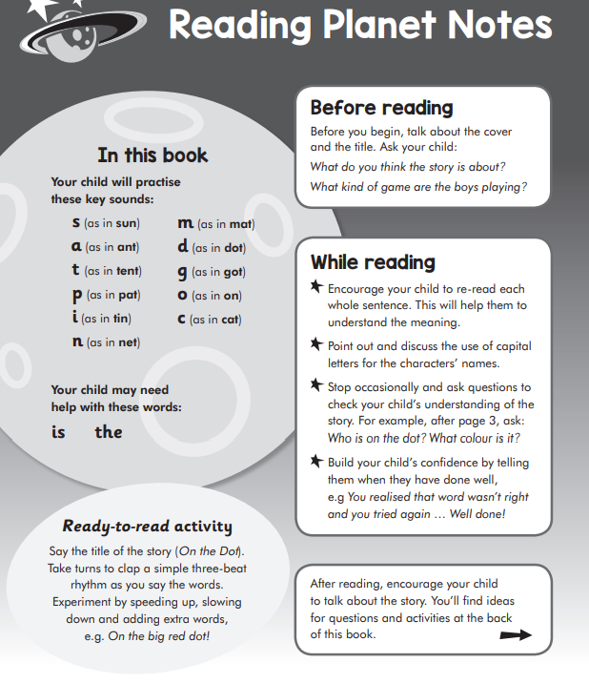

Slide 28
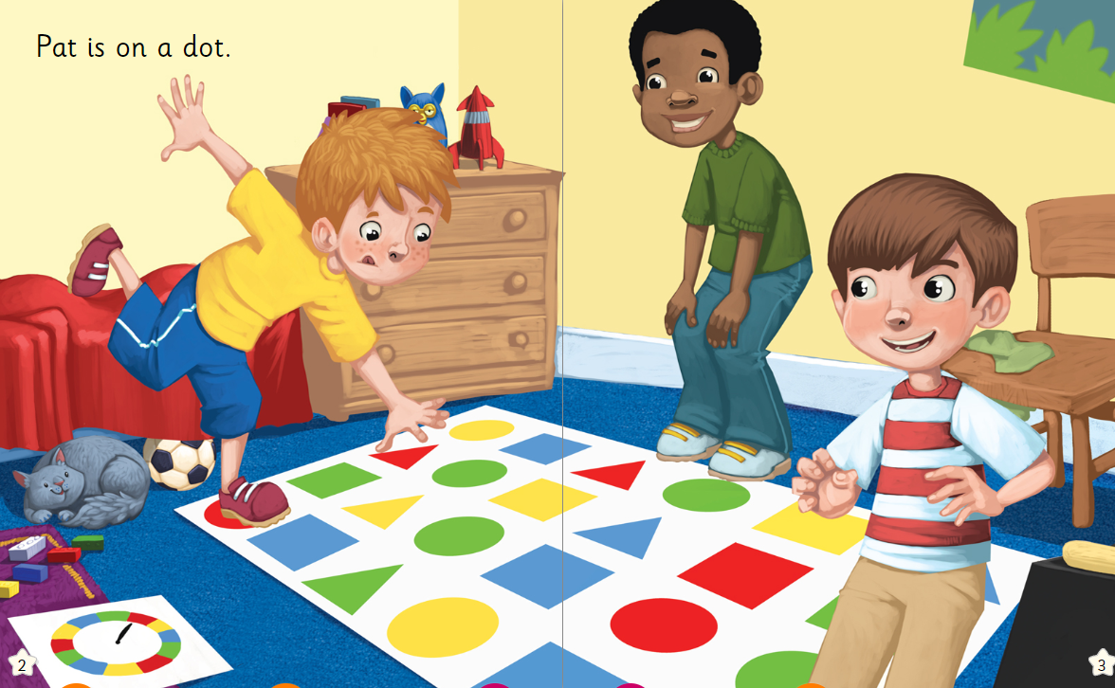
Point to the c-a-t
ch-air

Slide 29
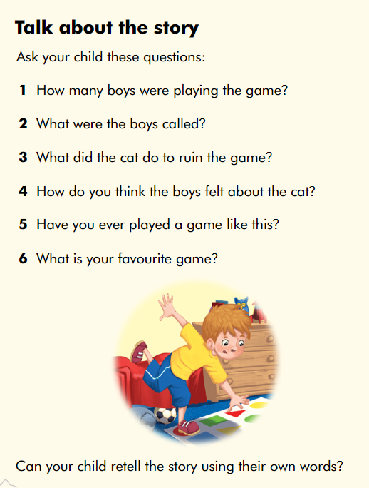

Slide 30
Please record in your child’s home school link book what they have read.
I.e. 1st read – Joe looked at the pictures and was able to oral blend to spot different things ☺
2nd read – pat √ dot √
Joe needed help with not
3rd read – Joe re-read the story well and was able to sight read dot.
4th read – 1. 3 boys
2. Pat
Children are able to look back in their book if they need to find the answer!

Slide 31
Most importantly…
Say sounds as pure as possible e.g. mmmmm, nnnnnn, p (not puh) etc
Don’t forget to talk about the story
Continue to read stories to your children for pleasure. We want to foster that love of reading!
There are many benefits of reading…. Language development, helps teach empathy, provides comfort, relaxation, happiness and fun, builds self-esteem, feeds imagination…

Slide 32

Notes:
Reading is the gateway to life. Reading allows children to access the curriculum… they are at the beginning of their exciting reading journey!

Slide 33
Thank you for coming!
Any questions?

