Slide 1

YEAR 6 SATs
Parent Meeting

Slide 2

Aims of this session
To share important information about KS2 SATs
To answer any questions about KS2 SATs
Discuss / share ideas about how you, as a parent, can help your child at home

Slide 3
What are KS2 SATs?
SATs are the Standardised Assessment Tests that are given to children at the end of Key Stage 2.
The SATs take place over four days, starting on
Monday 12th May ending on Thursday 15th May.
The SATs papers consist of:
○Grammar, punctuation and spelling (paper 1: GPS) – Monday 12th May
○Grammar, punctuation and spelling (paper 2: Spelling) – Monday 12th May
○Reading – Tuesday 13th May
○Maths (paper 1: Arithmetic) – Wednesday 14th May
○Maths (paper 2: Reasoning) – Wednesday 14th May
○Maths (paper 3: Reasoning) – Thursday 15th May
Writing is assessed using evidence collected throughout Year 6. There is no Year 6 SATs writing test.

Slide 4
How is SATs week organised?
The tests take place during normal school hours, under exam conditions.
Children are not allowed to talk to each other from the moment the assessments are handed out until they are collected at the end of the test.
After the tests are completed, the papers are sent away to be marked externally.
The results are then sent to the school in July.
Each test lasts no longer than 60 minutes:
○Spelling, punctuation and grammar (paper 1: Grammar/ Punctuation) – 45 minutes
○Spelling, punctuation and grammar (paper 2: Spelling) – 15 minutes
○Reading – 60 minutes
○Maths (paper 1: Arithmetic) – 30 minutes
○Maths (paper 2: Reasoning) – 40 minutes
○Maths (paper 3: Reasoning) – 40 minutes

Slide 5
Children with additional needs (who have similar support as part of day-to-day learning in school) may be allotted specific arrangements, including:
Additional (extra) time;
Tests being opened early to be modified;
An adult to scribe (write) for them;
Using word processors independently;
An adult to read for them (including a translator);
The use of prompts or rest breaks;
Arrangements for children who are ill or injured at the time of the tests.
Pupils with an EHCP are automatically allowed up to 25% additional time (except for the spelling paper, which is not strictly timed). Pupils who use the modified large print or braille versions of the tests are automatically allowed up to 100% additional time.

Slide 6
Grammar & Punctuation
There are two tests: a short spelling test and a longer paper testing grammar, punctuation and vocabulary.
The spelling test lasts approximately 15 minutes and pupils will need to spell words in context by filling in the gaps in sentences.
The grammar, punctuation and vocabulary test lasts for 45 minutes.
Pupils need a good working knowledge of technical vocabulary used to describe grammatical terms and punctuation marks.
Questions in the grammar test are focused around the following areas (called ‘content domains’):
- Grammatical terms/word classes
- Functions of sentences
- Combining words, phrases and clauses
- Verb forms, tenses and consistency
- Punctuation
- Vocabulary
- Standard English and formality
There are a range of answer types in the grammar test, including multiple choice and short one-word answers, but there will not be any long written answers required

Slide 7
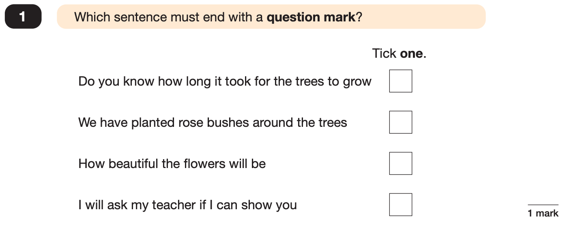
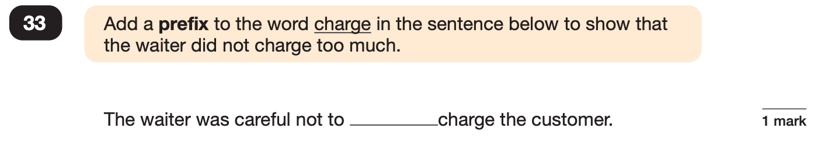
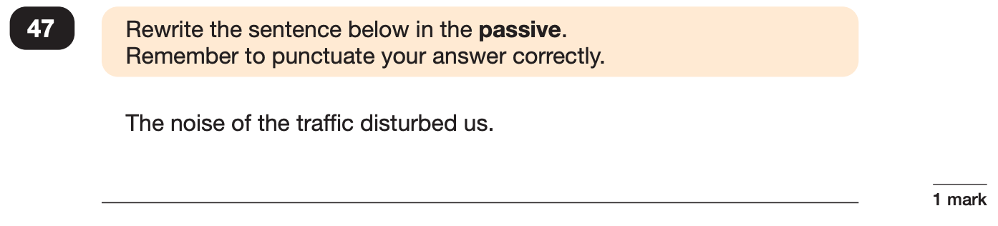
Grammar, Punctuation and Spelling: Paper 1 (GPS)
Example questions:
✓
over
e.g. We were disturbed by the noise of the traffic.
Notes:
Questions are from the 2024 GPS SATs paper.
For question 47 the answer scheme details several correct answers and answers that should not be accepted (e.g. misspellings of verb forms or errors in punctuation or capitalisation.)

Slide 8
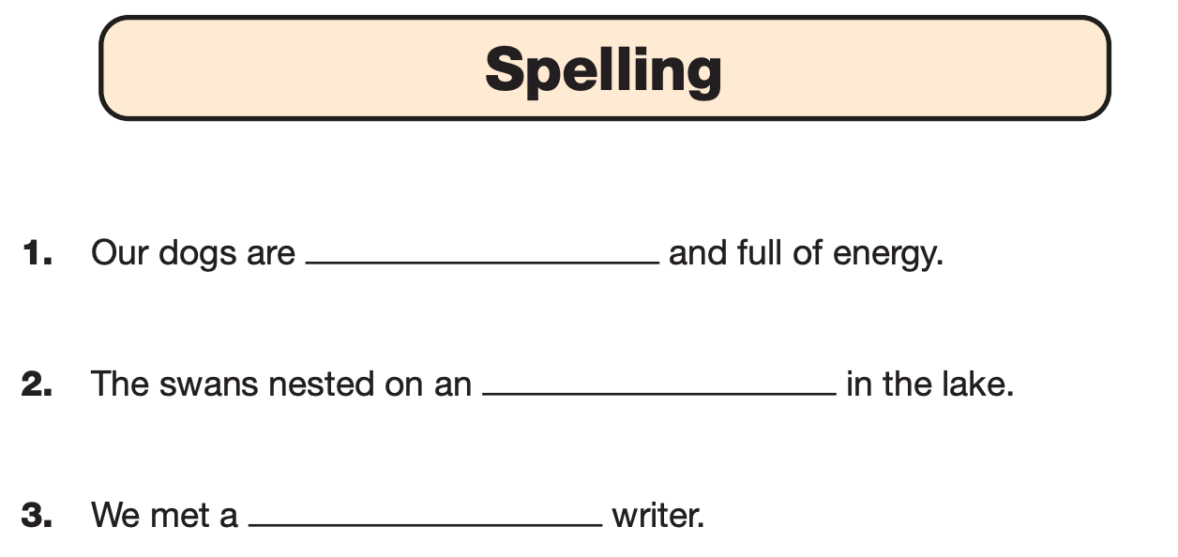
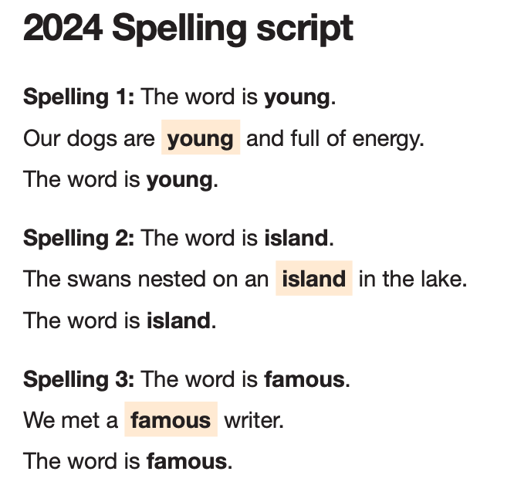
Grammar, Punctuation and Spelling: Paper 2 (spelling)
Paper 2 is a shorter paper that focuses solely on spellings.
Example questions:
Notes:
Questions are from the 2024 Spelling SATs paper.

Slide 9

Reading
1 hour to read booklet and answer questions.
There will be 3 extracts and 3 sets of questions which test their comprehension.
There are a variety of different questions to be answered in different ways.
Children cannot have any adult help in this test – completely independent.

Slide 10

Reading
Questions are focused around the following areas (called ‘content domains’):
- give/explain the meaning of words in context
- retrieve and record information/identify key details from fiction and non-fiction
- summarise main ideas from more than one paragraph
- make inferences from the text/explain and justify inferences with evidence from the text
- predict what might happen from details stated and implied
- identify/explain how information/narrative content is related and contributes to meaning as a whole
- identify/explain how meaning is enhanced through choice of words and phrases
- make comparisons within the text
There are a range of answer types, including multiple choice, short one-word answers and longer answers that require a written paragraph.

Slide 11
Reading
Since the current testing formation for the SATs began in 2016, there has been a tendency for three types of questions to be the most popular.
In the 2024 Reading SATs paper,
10% of marks could be gained from answering questions involving giving and explaining the meaning of words in context;
38% of marks could be gained from answering questions involving retrieving and recording information or identifying key details from a text;
44% of marks could be gained from answering questions involving making inferences from a text and justifying inferences with text evidence.
When reading with your child at home try focusing on these types of questions.

Slide 12
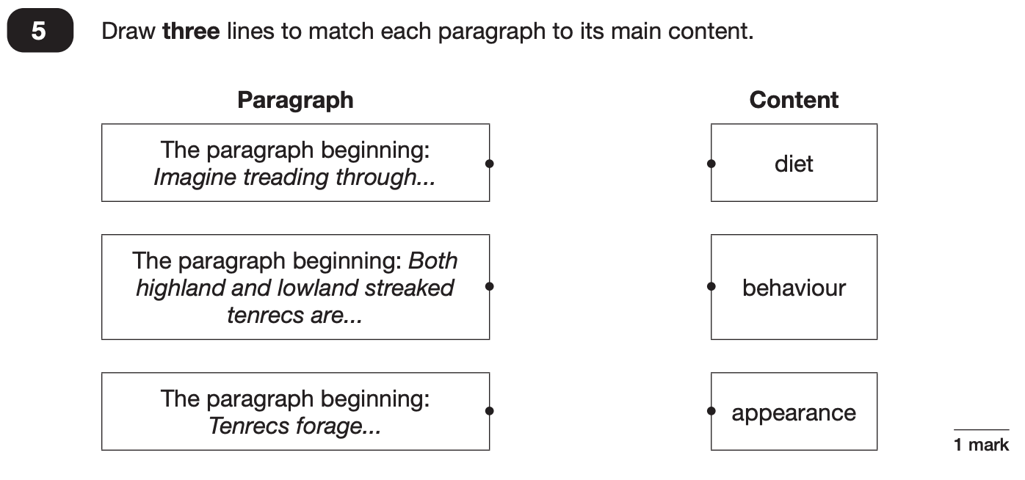
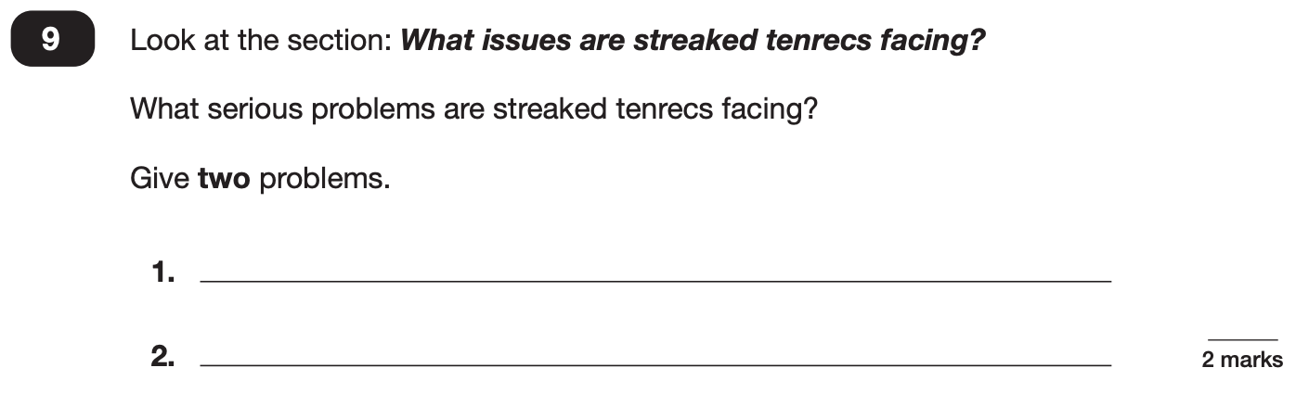
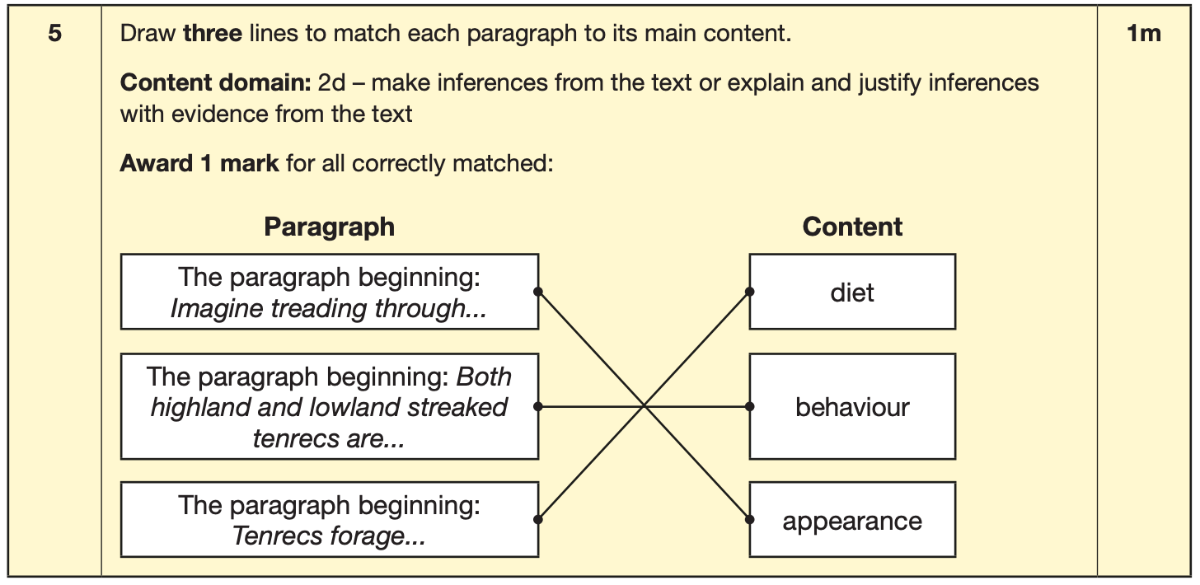
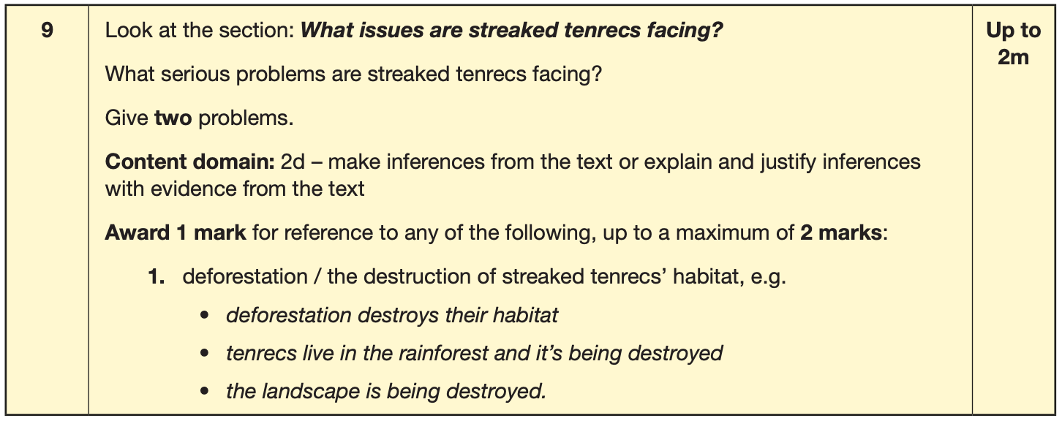
Reading
Example questions:
Notes:
Questions are from the 2024 Reading SATs paper.

Slide 13
Mathematics
There are three tests: one arithmetic paper and two reasoning papers.
Paper 1 (arithmetic) lasts 30 minutes and assesses pupils’ confidence using methods of calculation as well as fractions, decimals and percentages. It covers curriculum content from all of KS2. Worth 40 marks
Papers 2 & 3 (reasoning) last 40 minutes each and focus on problem solving, fluency and applying mathematical reasoning. Worth 35 marks per paper
Questions cover the following areas (called ‘content domains’):
- Number and place value
- Addition, subtraction, multiplication and division (calculations)
- Geometry – properties of shapes
- Geometry – position and direction
- Statistics
- Measurement
- Algebra
- Ratio and proportion
- Fractions, decimals and percentages.
Questions will increase in difficulty as the paper progresses

Slide 14
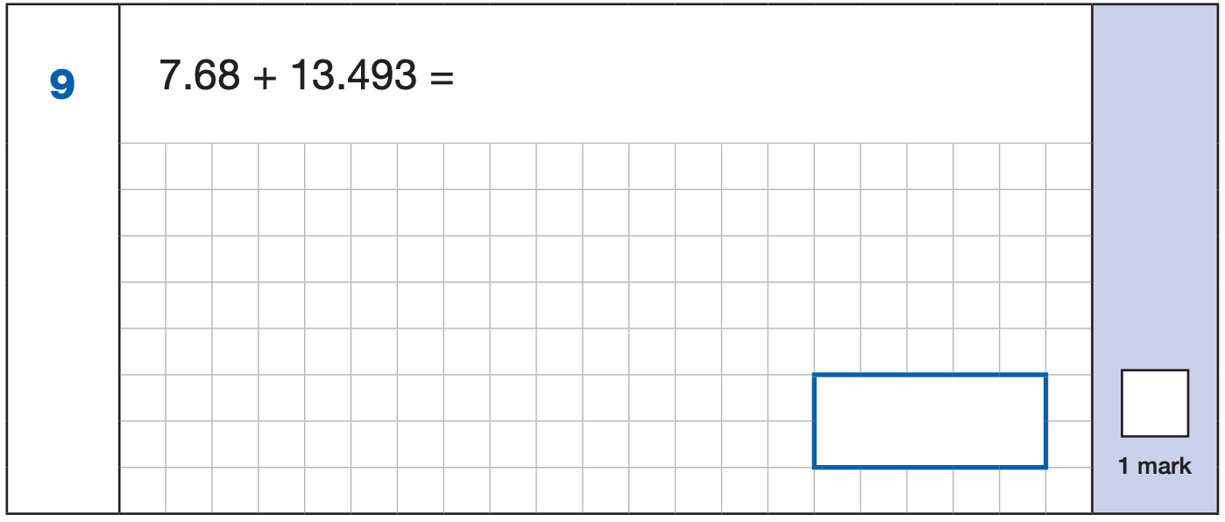
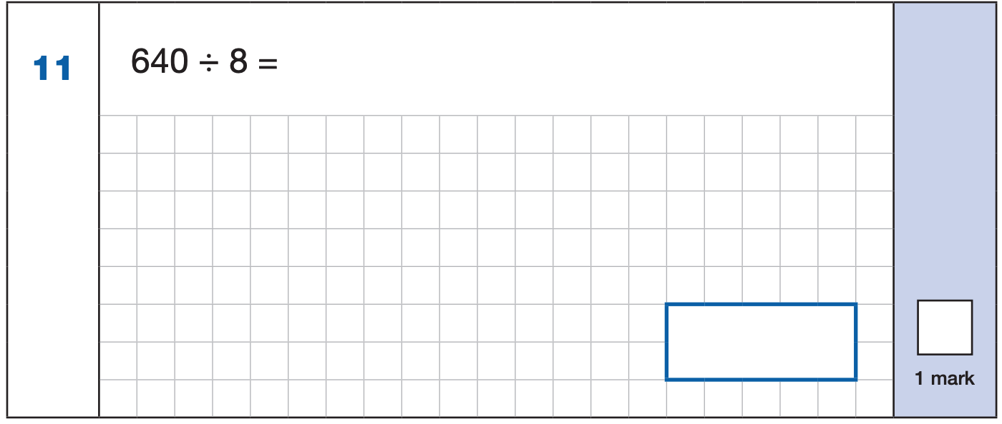
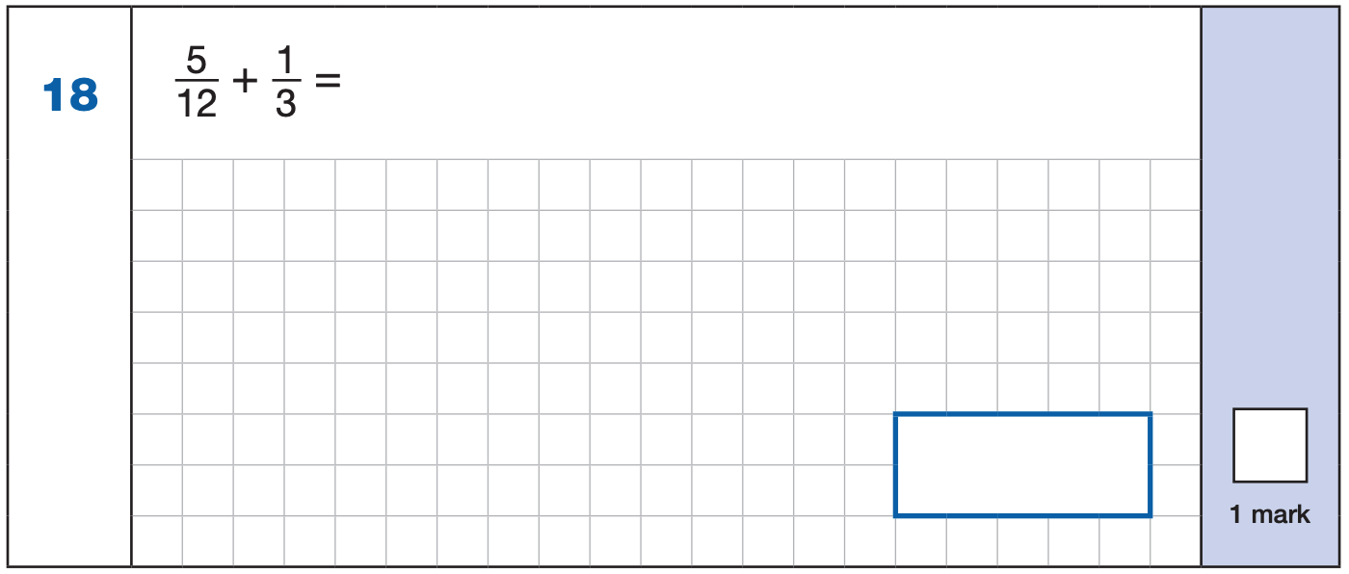
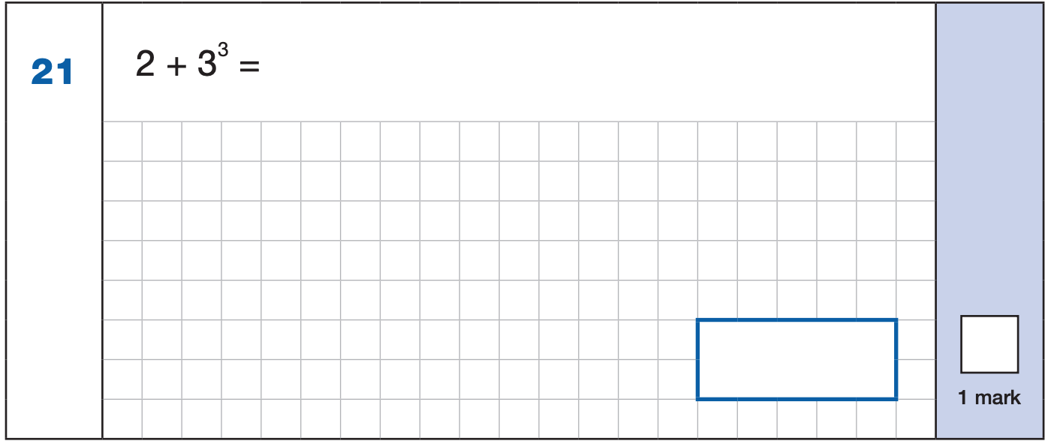

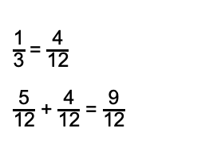
Maths Paper 1 (Arithmetic)
Example 1 mark questions:
7.680
+ 13.493.
21.173
¹ ¹ ¹
Mental method:
Using known fact of 64 ÷ 8 = 8
21.173
80
$\frac{\text{1}}{\text{3}}$ = $\frac{\text{4}}{\text{12}}$
$\frac{\text{5}}{\text{12}}$ + $\frac{\text{4}}{\text{12}}$ = $\frac{\text{9}}{\text{1}\text{2}}$
3³ = 27
2 + 27 = 29
$$\frac{\text{9}}{\text{1}\text{2}}$$
29
Notes:
Questions are from the 2024 Arithmetic SATs paper.
These are examples of how children could solve the calculations. There are some that could/ should be solved mentally as it is far quicker that way (40 marks in 30 minutes does not allow for 1 minute + per mark).
Answers should always be given in their simplest form unless stated otherwise.
Note that for question 18, equivalent fractions e.g. ¾ are accepted.

Slide 15
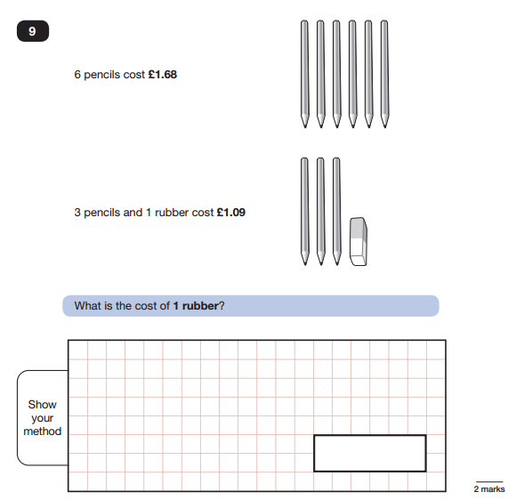
Maths Paper 2 / Paper 3 : Reasoning
Sample Questions

Slide 16
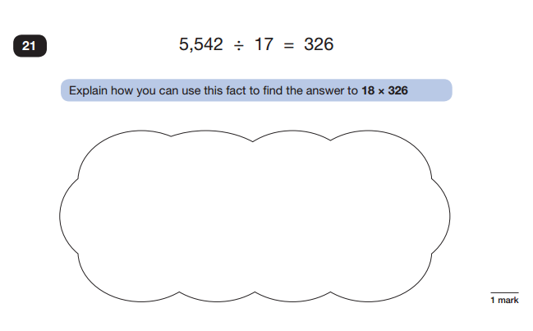
Maths Paper 2 / Paper 3 : Reasoning
Sample Questions

Slide 17
How can you help with maths?
Support with homework – not just helping with finding the answer, but reading the question and asking your child to explain in their own words what is being asked and their method.
·TIMES TABLES!!! Learning them as well as using and applying them.
·Help your child to check their work through – this will help them to spot mistakes that can sometimes be easily fixed.
Resources:
Past papers.
CGP exercise books.
White Rose and Oak National Academy

Slide 18
Scaled scores
100 will always represent the ‘national standard’ (the expected standard).
Each pupil’s raw test score will therefore be converted into a score on the scale. The scale will have a lower end point somewhere below 100 and an upper end point above 100.
A child who achieves the ‘national standard’ (a score of 100) will be working at expected.
In July 2025 the test results will be published and each pupil will receive:
> A raw score (the actual score on the paper).
> A scaled score in each tested subject.
> Confirmation of whether or not they attained the national standard.

Slide 19
Scaled scores
On publication of the test results in July 2024:
·A child awarded a scaled score of 100 is judged to have met the ‘national standard’ in the area judged by the test.
·A child awarded a scaled score of more than 100 is judged to have exceeded the national standard and 113 is demonstration that a higher than expected knowledge of the curriculum for their age has been reached.
·A child awarded a scaled score of less than 100 is judged to have not yet met the national standard and performed below expectation for their age.

Slide 20

Writing
Writing is teacher assessed.
Throughout the year, evidence of your child's writing is accumulated to support the teacher's assessment judgement.
Children need to demonstrate their level of writing in all subject areas, not just in English.

Slide 21
Supporting your child in preparing for the SATs
Firstly, a positive attitude goes a long way. Give them as much encouragement and support as you can (but we don’t need to tell you that)!
Tips:
Don’t use past papers as they are used in school to prepare the children.
Talk to me if you have any concerns.
Encourage your child to talk to me or a trusted adult (including yourself) about their anxieties. Don’t forget that a small amount of anxiety is normal and not harmful.
Give your child a quiet, distraction free space to complete homework or study.
Give your child time to go outside and reduce screen time.
Ensure your child is eating and drinking well and getting a good amount of sleep.
Plan something nice and fun for the weekends before and after SATs. This will help them to relax before the SATs and give them something to look forward to after.

Slide 22

Other ways you can help
Attendance - ensure your child is in school as much as possible.
Regular and appropriate bedtimes.
Revision balanced with breaks and physical activity.
This is a chance to show off the hard work they have done in KS2 – and a 'You can do it!' attitude.
This is an important term, but your children are the MOST important thing!
We need to look after them!

Slide 23

During the SATs week
·Let school know as early as possible if your child is ill during test week and if any special arrangements need to be made.
·Communicate if there has been any upheaval or upset at home that may affect the pupil’s access/performance in the test.
·Ensure your child has breakfast, a bottle of water, a good night's sleep and a healthy snack in test week.
8:20 – 8:50

Slide 24


