Slide 1


Meet the team
Sapphire Class
Reception– 2025/26

Slide 2

The Sapphire Class Team
Miss Lisa Wallage (Monday, Wednesday- Friday)
Ms Jyoti Metla (Tuesday)
Teaching Assistants
Mrs Esther Herbert (Mon, Tues, Wed)
Mrs Lucy Parsons (Thurs)
Miss Jamie Moss (Fri)
Sports teacher
Mr Orriss – Wednesday morning

Slide 3
What your child needs for school
Book bag - to fit in tray
A named water bottle and snack.
This needs to be a ‘healthy fruit snack’ for break time. (Please help your child to practise opening and closing their snack pots and water bottles).
Wellington boots
Hat – according to the season
They will need to come to school in their PE kit instead of uniform on PE days. (Wednesdays)
Please name all items
Notes:
Fruit for snack please unless your child has a specific need in which case please talk to us. We aim to be a healthy school and many snacks for children have hidden sugar. No nuts or chocolate.

Slide 4

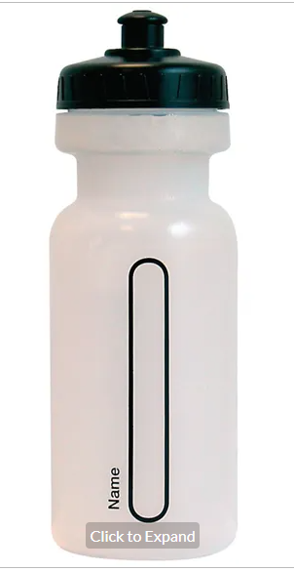
Water bottles & Snack
Only water bottles with sports cap to avoid spills
No novelty water bottles
Maximum size 750ml (to be refilled when empty)
Only water in the bottles please
Snack;
  Fresh fruit, vegetables, plain bread sticks and/or crackers
  No snacks containing high sugar, salt or fat ie fruit winders etc

Slide 5
A Day in Sapphire Class
Doors open at 8.40am
'Get Busy' time and registration
Session 1 Phonics and continuous provision
Snack
Session 2 Maths and continuous provision
Lunch and Playtime
Registration
Session 3 Topic and continuous provision
Snack
Storytime
Doors open for hometime at 3.15pm

Slide 6
What to do in the morning…
The children enter the classroom through the outside door.
There will be activities set up around the room for the children to come and play with when they first enter.
As far as possible, parents and carers leave children at the classroom door and do not come in.
If you are picking your child up early please collect them from the main entrance by the office.
Notes:
If your child is struggling with separation they can become more upset with long drawn out goodbyes. It is best to say a quick goodbye and leave. They will be fine! This may change depending on Covid-19-we will keep you updated with regard to new drop off and pick up arrangements

Slide 7
What to do in the morning…
Water bottles and snack pots: These go in the baskets and boxes outside the classroom before the children come into school.
Hats: In our ‘Hat box‘
Lunchboxes: In round tub. Your child will be entitled to a free school meal.
Home learning folders: In the pink box on Thursdays
When they come in:
Coats: On their pegs.
Book bags: In own trays
Notes:
Everyday your child needs to bring to school their book bag, reading record, snack pot and water bottle. They will have a designated day for PE- Wednesday. The Class newsletter will inform you of the PE day for Sapphire.
Please allow the children to become as independent as possible and let them put their things away.
After half term we would like all the children to be entering the classroom unaccompanied in the morning.
Please ensure that everything the children bring to school has their name on it. Even socks and underwear! Please ensure that your child knows where the label is and that they are able to recognise it.
The children can not have a backpack, they need to have a book bag that fits into their tray and their PE kit in a drawstring bag. Book bags :Please use a school book bag as they fit in trays well
P.E. bags: Please use a school PE bag as they fit well on the pegs in cloakroom

Slide 8

Foundation Stage curriculum
We will cover many topics over the year including:
Who am I? How do we celebrate?
Can you tell me a story? Do all heroes wear capes?
What can you find in our world? What changes can you see?

Slide 9
Foundation Stage Curriculum
There are seven areas of learning and development in the EYFS which include:
Prime areas
Communication and Language
Listening, Attention & Understanding
Speaking
Personal, Social and Emotional Development
Self-Regulation
Managing Self
Building Relationships
Physical Development
Gross Motor Skills
Fine Motor Skills
Specific areas
Literacy
Comprehension
Word Reading
Writing
Mathematics
Number
Numerical Patterns
Understanding the World
Past & Present
People, Culture & Communities
The Natural World
Expressive Arts and Design
Creating with Materials
Being Imaginative & Expressive
We have an on-entry screening for each child which is statutory.

Slide 10
Reading at Home
We value reading as a key life skill and are dedicated to enabling our children to become lifelong readers. We believe reading is key to academic success.
Your child will have a fully decodable book and a library book each week.
Please read stories to/with your child every day at home and then sign to show you have read with them in their reading record book.
Your child’s reading book and reading record need to come to school everyday.
Here is a link to a suggested reading list for Reception children which you may find helpful when choosing other books to read at home. Books for Reception. Great Reads for 4-Year-Olds (schoolreadinglist.co.uk)
Notes:
. The boxes are colour coded, this ties in with which level your child is reading (this will be on your child’s reading record).Children will be assessed as to which reading level is appropriate for them-we aim to read with and review children’s reading regularly.
The record book is also an effective way of communicating with the team as we aim to look at it every day however we cannot guarantee this so in the case of an emergency please email or call the office. There will also be a class email to contact the team with but again in an emergency please call the office.
Reading every day with your child and to them is the most effective thing you can do to promote their progress not only in school but through life! Ideally they will with your help read their reading book and listen to a story with you too.

Slide 11

Home Learning – Phonics
Weekly sounds and common exception words will be displayed on the whiteboard outside the classroom.
Please use the 'I can blend' sheets to reinforce
the reading and writing of the sounds.
We will have a phonics workshop for parents in the Autumn term.

Slide 12
Home Learning – Maths
Please enjoy playing lots of different games with your child e.g. board games with dice, dominoes, card games, memory games etc. This will help them to develop reasoning and strategy.
Spot numbers in the environment
Use any opportunity to count e.g. How many cups do we need? Count as you walk up the stairs etc!
We will have a Maths workshop for parents in the spring term.

Slide 13
Home Learning​
And other important skills...
Go to the park and climb, hang on the monkey bars, develop the muscles needed for writing.
Practise using scissors to cut paper and card.
Talk with your child, ask and answer questions eg I wonder …
Be independent in the toilet

Slide 14
Any Other Business
Uniform – All uniform including PE Kit must be clearly named.
Clubs - Earlybirds will run from 7.30am and Owls club from 3.15pm – 5.30pm.
Children in infant classes should only have a book bag that can fit in their tray.

Slide 15
Is your child going home with someone else?
Please fill in a form and give to one of the class adults. It's useful if we have met any other adults that are collecting- particularly in the early days!
We will ask you for a password when we visit in September.
Notes:
If your child is not going home with you that day, then you need to complete the form in the morning and hand it to one of the team. If you forget please phone through to the office and they will let us know. We do not allow to let your child go home with anyone else unless we have your permission.

Slide 16
Induction for September 2025
Meet the Team – Thursday 3rd July
Stay & play (am) – Fri 11th July (3 groups)
Art session (am) – Fri 18th July (3 groups)
September
Home visits
Thursday 4th, Friday 5th, Monday 8th

Slide 17
Friday 12th September
All children in 8.40am – 1pm
Monday 15th September onwards
Children in full time

Slide 18
Stay and play morning –September
Arriving at 5 minute intervals
Tuesday 9th collect at 1pm
or
Thursday 11th collect at 1pm

Slide 19

Getting your child ready for school…
The most important things you can do to support your child's transition are:
Enjoy sharing stories and nursery rhymes together (Summer Reading Challenge with local library)
Promote their independence – dressing/ undressing/ putting on coat and using the toilet independently
Encourage them to eat with a knife and fork and carry plates to and from the table and clear their own plate
Practise recognising and writing their name (using correct pencil grip and letter formation)

Slide 20
Getting your child ready for school…
Improve familiarity with numbers – hunting for different numbers when out walking, pairing socks together
Play games (memory games, rhyming games and board games with dice). This makes a really significant difference to children's cognitive ability and ability to recognise number and word patterns.
Have fun and enjoy the Summer!

Slide 21
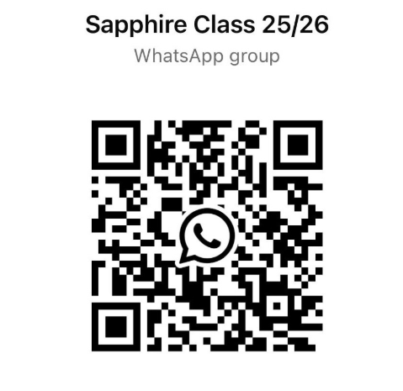
Paperwork
Forms in folders
Home School Agreement
Before the end of term please!
FOTSA
Parent WhatsApp – QR code

Slide 22
Finally!
Please feel free to discuss any aspect of your child’s learning with us. Working together we can make the transition as smooth as possible.

Slide 23

Thank you!
We look forward to seeing you in September!
Miss Wallage and Ms Metla
sapphireclass@thorpe.surrey.sch.uk

