Slide 1

Meet the team
Emerald Class
Year 1 – 2025/26
Through Christ who strengthens us, all will flourish at our school, with Faith, Love and Excellence.

Slide 2

The Emerald Class Team
Class Teachers
Mrs Maher (Monday-Wednesday)
Mrs Warren (Thursday and Friday)
Teaching Assistants
Mrs Wade (Mon, Tues)
Mrs Elmer (Wed, Thurs, Fri)

Slide 3
Our Mission Statement
As learners we will be enquiring, self-motivated, resilient and desire excellence.
As individuals we will have a Godly sense of right and wrong and have the opportunity to explore and develop our faith.
As citizens we will develop love, confidence, discipline and enjoy contributing to our community and our world.

Slide 4

Golden Rules
1. We look after each other and our school.
2. We respect others and ourselves.
3. We tell the truth and learn from our mistakes.
4. We try our best and don’t give up.
5. We encourage one another.
Our Values

Slide 5
Reception to Year 1
Year 1 aims to build upon early learning experiences with the introduction of the National Curriculum. It may seem like a big step and we want to ensure that the transition into Year 1 is as smooth as possible!
The children will have the opportunity to become familiar with the new classroom environment and will be popping into the classroom every now and then over the next couple of weeks!
Transition morning is on Friday 18th July
There will be lots of similarities as we will ensure the learning environment and routines are as similar to reception as possible.
Over the year, the learning environment will change and the school day will become more structured and they will be expected to sit at a table for longer periods of time.
We will continue to learn in a variety of ways such as through play, practical activities, group work, drama and games! We will have lots of fun!

Slide 6

Timings for the school day
 | KS1 daily schedule
8.40
8.50
9.30
10:30
10:45
11.00
12.00 | Handwriting/ Mastering Number
12.15
13:15 | Paired reading
13:30
15.15
Doors open, morning activity and register
Phonics
English
Snack and playtime
Whole School Collective Worship
Maths
Lunch and Playtime
Foundation Subjects
End of the school day
Notes:
This is the rough timetable for the day. There may be a few changes but it generally follows the same routine as in Sapphire class

Slide 7
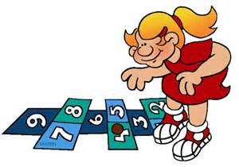





Developing fluency, reasoning and problem solving in Maths
Number
Count to and across 100, forwards and backwards beginning with 0 or 1, or from any given number
Count, read and write numbers to 100 in numerals
Count in multiples of 2s, 5s and 10s
Given a number, identify one more and one less
Identify and represent numbers using objects and pictorial representations including the number line, and use the language of: equal to, more than, less than (fewer), most, least
Read and write numbers from 1 to 20 in numerals and words
Addition and Subtraction
Read, write and interpret mathematical statements involving addition (+), subtraction (-) and equals (=)
Represent and use number bonds and related subtraction facts within 20 e.g. 5 + 2 = 7, 7 – 2 = 5, 7 – 5 = 2
Add and subtract one-digit and two-digit numbers to 20, including 0
Solve one-step problems that involve addition and subtraction using concrete objects and pictorial representations, and missing number problems such as 7 = ? – 9
Multiplication and Division
Solve one-step problems involving multiplication and division, by calculating the answer using concrete objects, pictorial representations and arrays with support of the support of an adult
Year 1
End of year expectations
Measurement
Compare, describe and solve practical problems for:
Lengths and heights e.g. long/short, longer/shorter, tall/short, double/half
Mass/weight e.g. heavy/light, heavier than/lighter than
Capacity and volume e.g. full/empty, more than, less than, half, half full, quarter
Time e.g. quicker, slower, earlier, later
Measure and begin to record the following:
Lengths and heights
Mass/weight
Capacity and volume
Time (hours, minutes, seconds)
Recognise and know the value of different denominations of coins and notes
Sequence events in chronological order using language such as after, next, first, today, yesterday, tomorrow, morning, afternoon, evening
Recognise and use language relating to dates, including days of the week, weeks, months and years
Tell the time to the hour and half past the hour and draw the hands on a clock face to show these times
Geometry (including position and direction)
Recognise and name common 2-D and 3-D shapes, including:
2-D shapes e.g. oblong, square, circle, triangle
3-D shapes e.g. cube, cuboid, pyramid, sphere
Describe position, direction and movement, including whole, half, quarter and three-quarter turns e.g. describing a route using language such as forward, backward, left and right
Fractions
Recognise, find and name half as 1 of 2 equal parts of an object, shape or quantity
Recognise, find and name a quarter as 1 of 4 equal parts of an object, shape or quantity
Notes:
Briefly talk about a few areas

Slide 8


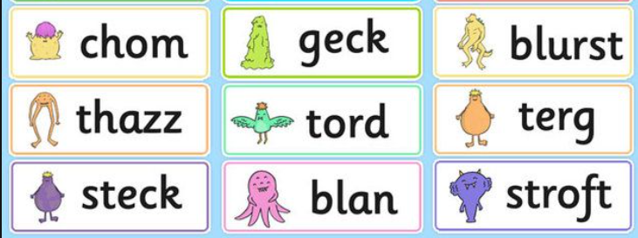
English
Literacy is an important life skill and lays the foundations for lifelong learning.
We develop children’s literacy skills through
Talk
Speaking and Listening
Phonics
Reading
Writing
Handwriting
We will look at a range of fiction, non-fiction and poetry.
There will be a bigger focus on Spelling, Punctuation and Grammar.
Year 1 Phonics Screening check – June 2026

Slide 9
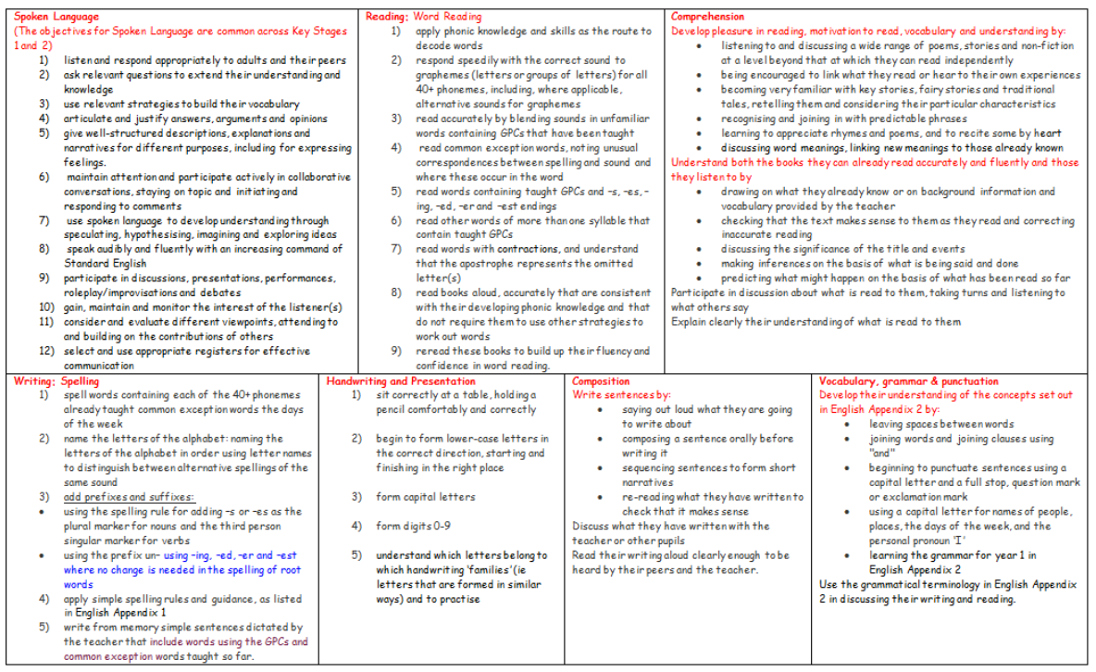

Slide 10
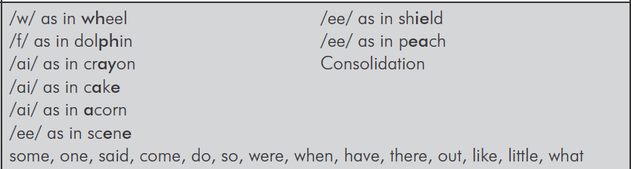
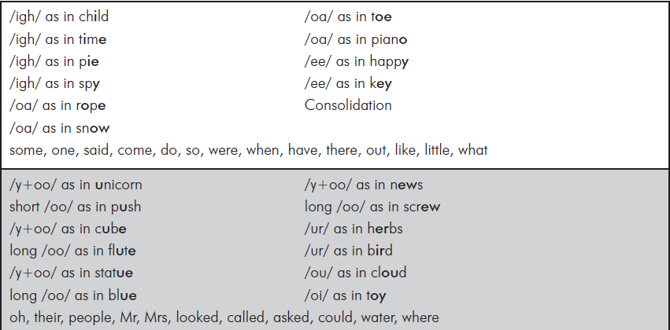
Year 1 Phonics and Common Exception Words

Slide 11
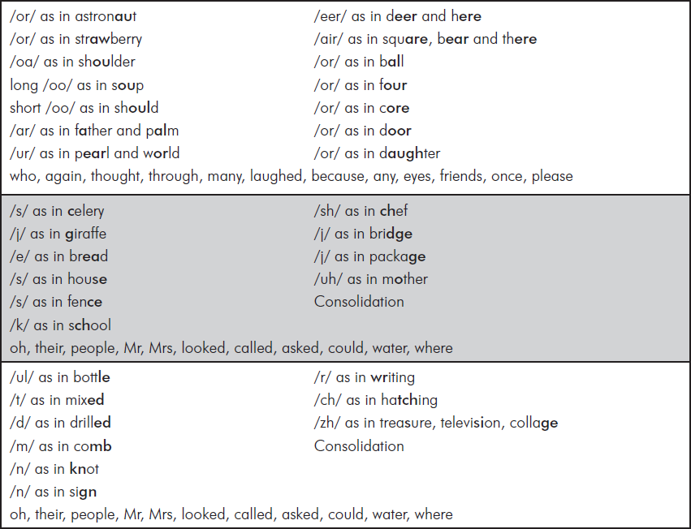
Year 1 Phonics and Common Exception Words

Slide 12
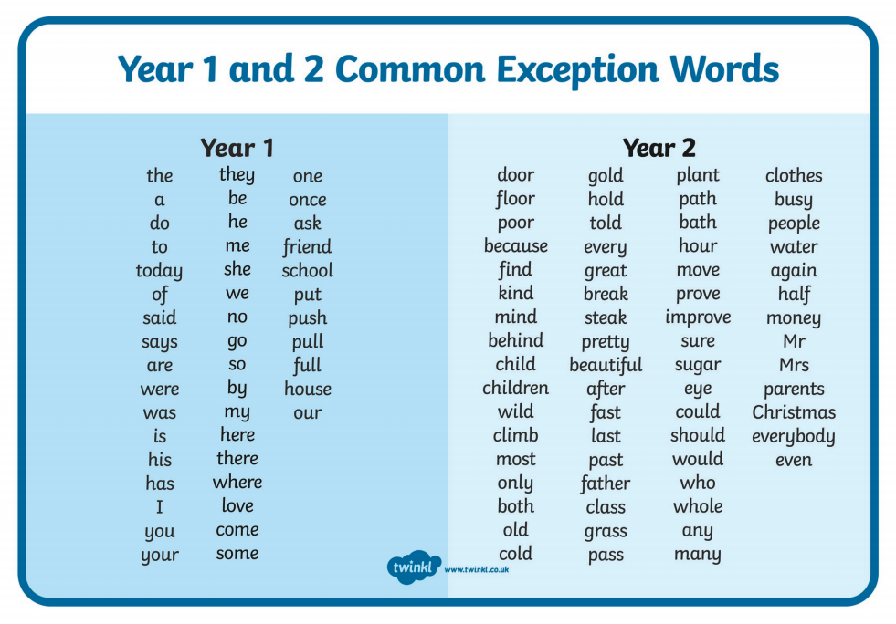

Slide 13
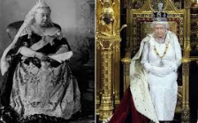

Year 1 Curriculum
Our Topics:
History:
What mattered most to our two famous Queens, Queen Victoria and Queen Elizabeth II?
How have toys changed?
What was life like in a medieval castle?
Geography:
What is the weather like around the world?
How can we find our way around our school?
Is Britain an island?

Slide 14

Year 1 Curriculum
Our Topics:
Science:
Seasonal changes
Materials
Plants
Animals & Humans
R.E: Guildford Diocese Guidelines – Christianity and one other religion
Other subjects will be linked to our topics where appropriate. Art, Music, P.E, D&T, Computing, PSHE.

Slide 15


PE and Games
PE will be on a Wednesday with Mr Orriss and one other day – day to be confirmed asap
Children to come into school with their PE kit on these days. Please ensure they are equipped with the P.E. uniform and appropriate footwear. The school PE Kit includes yellow polo shirts, shorts for gym and joggers for outside in cooler weather.

Slide 16
How can I support my child?
Our Mission Statement
As learners we will be enquiring, self-motivated, resilient and desire excellence.
Exploring the world around us, trying new things, having a positive mindset ‘I can do this!’
As individuals we will have a Godly sense of right and wrong and have the opportunity to explore and develop our faith.
Making the right choices, supporting us with behaviour expectations and learning from our mistakes
As citizens we will develop love, confidence, discipline and enjoy contributing to our community and our world.
Caring for others, developing empathy, showing respect to others and the classroom

Slide 17
How can I support my child?
Talk, talk and talk!
Read, read and read! (Listen at least 3 times a week and read to your child regularly – we want to foster that love of reading!)
Limit screen times
Good breakfast and water before school
Keep us up to date of any changes/ news
Talk positively about school and show interest!

Slide 18


Home Learning
Reading at home
Here is a link to a suggested reading list for Year 1 children which you may find helpful when choosing other books to read at home.
Books for Year 1. Great Reads for 5-Year-Olds (schoolreadinglist.co.uk)
Pop into your local library for more information

Slide 19
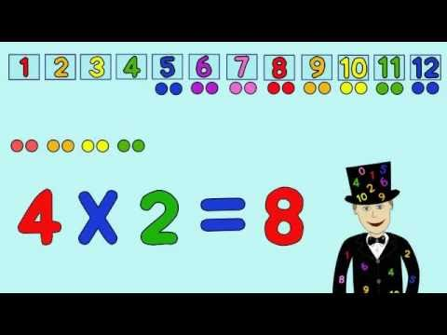

Home Learning
Maths – Activities on topic grid and Games will be sent home (from time to time)
1 minute maths
Topic – Half termly or topic grid with choice of activities

Slide 20


We are a healthy school
Only water bottles with sports cap to avoid spills
No novelty water bottles
Maximum size 750ml (to be refilled when empty)
Only water in the bottles please
Snack;
  Fresh fruit, vegetables, plain bread sticks and/or crackers
  No snacks containing high sugar, salt or fat ie fruit winders etc

Slide 21
Other Business
Uniform – All uniform including PE Kit must be clearly labelled.
Clubs - To be confirmed in the new term. Earlybirds will run from 7.30am and Owls club from 3.15 – 5.30pm.
Children in KS1 should only have a book bag not a rucksack as space in the cloakrooms is at a premium
Finally!
Please feel free to discuss any aspect of your child’s learning with us. Working together we can make the transition as smooth as possible.

Slide 22

Any questions?

Slide 23

Thank you!
We look forward to working together!
Mrs Maher and Mrs Warren

