Slide 1
Welcome to Ruby Class!
Mrs George – Class Teacher (Monday and Tuesday)
Mrs Graham – Class Teacher (Wednesday ,Thursday and Friday)
Mrs Mellor – Teaching Assistant (Monday, Tuesday, Wednesday)
Mrs Wade – Teaching Assistant (Thursday, Friday)
Mrs Sevier, Mrs James, Mrs Chamberlain- SNAs

Slide 2

School Day
8.40: Doors open
8.45: Registration
8.50: Phonics
9.30: English
10.30: Break
10.45: Collective worship
11.00: Maths
12.00: Mastering Number
12.15: Lunch
1.15: Foundation Subject
2.15: Afternoon snack
2.20 : Paired Reading/Foundation Subject
3.00: Story
3.15: Home time

Slide 3

The Curriculum
English
  Rocket Phonics
  Reading
  Writing
  Spelling, Grammar and Punctuation (Phonics)
  Handwriting (Phonics)
Mathematics
  Arithmetic and Fluency
  Reasoning
  KIRFs
  Topic – Science, RE, History, Geography,
PSHE, Art, D&T, Music, PE, Computing

Slide 4
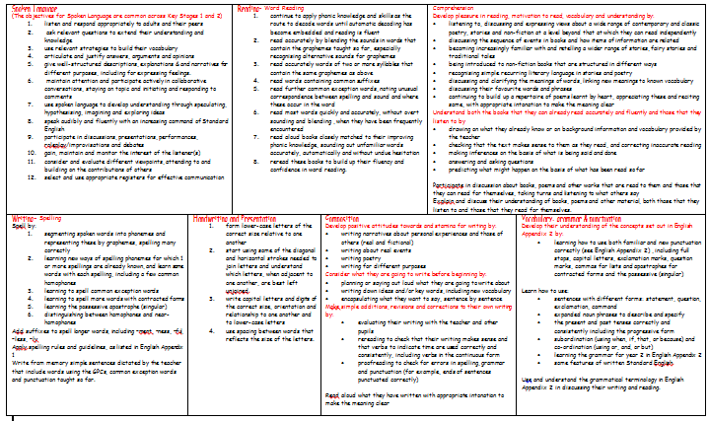

English
English National Curriculum
Daily Phonics Lessons (Rocket Phonics)
Paired Reading
Daily English lessons
Range of genres
Fiction: Traction Man, Toby and the Great Fire of London, Prince Cinders, The Tunnel
Non-fiction: Life Cycles, The Great Fire of London, Instructions, Riddles, Animal Homes, Persuasive Letters
Poetry: The Owl and the Pussy Cat, The Sound Collector

Slide 5
Reading at Home
How can you help your child in English?
Encourage your child to read for pleasure – fiction, non-fiction, poetry
Be a good role model – echo reading, take it in turns
Little and often
Re-read a book more than once
1st read = Look at the pictures and talk about what is happening​
2nd read = Ask your child to read the book concentrating on the phonics on the inside front cover.​
3rd read = Focus on using a storyteller voice and developing fluency for the words read. ​
4th read = Ask your child questions about the story to develop their comprehension. ​
Please write a comment in your child’s home-school link book if you have heard your child read at home.
Sticker– read at least four times each week

Slide 6
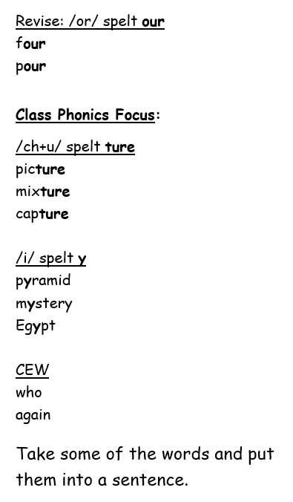
How can you help your child in English?
Practise phonics: Words linked to the focus phonics for the week are sent home every Tuesday. Please help your child to embed the sounds and write words containing the sounds within sentences.
Children are to hand these books back in on a Monday.
Also please practise reading and writing the Year 1 and 2 CEW. This will support their reading and writing fluency.

Slide 7

I Can Blend

Slide 8
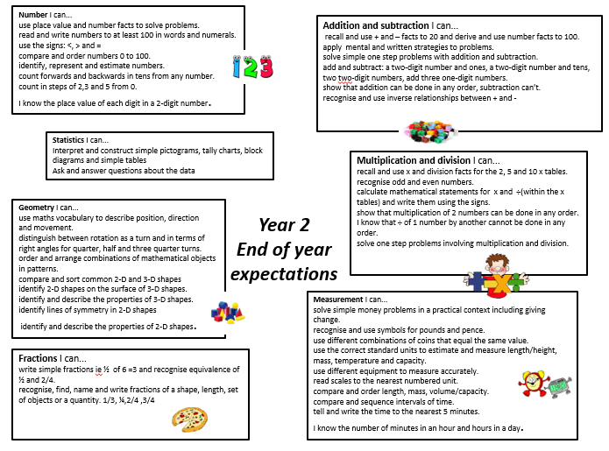

Maths
Daily maths lessons
Arithmetic
Fluency
Reasoning and Problem Solving
Morning maths (retrieval)
Mastering Number
KIRFs
How can you help your child in Maths?
Counting in 2s, 3s, 5s and 10s – forwards e.g., 0, 2, 4, 6, 8, 10 up to 20 and then 20, 18, 16, 14 etc.
Tell the time on an analogue clock (o’clock, half past, quarter past and quarter to). Once they are secure with these then they can go onto telling the time to the nearest 5 minutes.
Understand the value of each coin. How can you make 23p? What can I buy for £1? How much change will I get from…?
Measuring weight, length and capacity
Problem solving – e.g. I want to buy 20 cakes. There are 5 cakes in each box, how many boxes do I need to buy altogether? Max gets £2 pocket each week. How much money will he have after 6 weeks?
Maths games on MathsShed and White Rose 1 Minute maths app.
Digit Games – every other Friday (Mastering Number Home Learning)

Slide 9
Curriculum
Science – Growth and Survival, Materials, Super Scientists, Plants
RE – We follow the Guildford Diocese Curriculum
3 Christianity topics
2 Islam topics
Thematic Unit – Giving and Receiving
Topic
Marvellous Me - Thorpe
Remember Remember – Great Fire of London
Once upon a time – Cinderella and Prince Cinders, How to Trap a Dragon
Amazing Animals - Habitats
What a wonderful world! – Africa (Sierra Leone)
Growth and Movement - Plants and Transport
Trips – Brooklands Museum and Africa Day

Slide 10

Rewards
Golden Rules/Class Rules – marble in a jar
Golden Time
Team points – work in books/following the Golden Rules
Stickers for frequent reading

Slide 11

Home Learning
In addition to the reading, phonics and Maths mentioned, children will also receive …
Topic based Home Learning
Children will have a choice of 6 activities every half term. We ask them to complete at least one, but they can do more if they wish.
Marvellous Me
Each Friday a child will have the opportunity to bring in a special item from home that they can share with the class. Please return the bag by Friday so other children get their turn.
Clubs
Early Birds and Owls club. Other clubs and activities to be confirmed at the beginning of term.

Slide 12

Pride in our Uniform
Wearing the correct uniform to school is important. Please support us in ensuring your child comes to school wearing their uniform in a smart way.
No earrings on PE days
Children to wear PE kits on Mondays and Wednesdays.
Foundation Stage and Infant (age 4 - 7) Reception Year, Year 1 and Year 2
Girls | Boys
Yellow polo tops with school logo
Grey trousers or shorts
Grey skirts or pinafore dresses
Summer dresses blue and white check*
Sweatshirts/cardigans royal blue
Socks black , grey or white
Tights grey, black or royal blue
Black shoes
P.E Uniform
Yellow T-shirts with school logo Royal Blue Tracksuit Trousers Navy shorts Black/Navy leggings Trainers or Black Plimsols

Slide 13

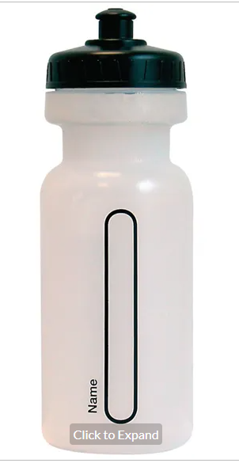
Water bottles & Snack
Only water bottles with sports cap to avoid spills
No novelty water bottles
Maximum size 750ml (to be refilled when empty)
Only water in the bottles please
Snack;
  Fresh fruit, vegetables, plain bread sticks and/or crackers
  No snacks containing high sugar, salt or fat i.e. fruit winders etc

Slide 14
How can you help?
  It is important that we have a fair and consistent approach to our school rules therefore please support us by following our requests.
  It is particularly important for you to ensure your child is following our school behaviour policy, especially if we ask for your support at home. Also, that they have the correct:
  Footwear & uniform (including PE uniform)
  Water bottle with pop lid to avoid spills
  No high sugar or salt snacks
Notes:
Support your child with Home learning activities; especially reading & times tables…
Attend FOTSA events and support with getting events ready… so important for the extra things we are able to offer our children; Opal Play, Swimming, trips and events to name a few
Come along to parent Voice meetings and help others to express their worries, concerns, share things they are happy with, offer solutions for things we can fix.
Consider coming along to help in your child’s class – please note that you will need to have a safeguarding talk with me before helping in school.
Share your worries with us and we will do our best to make things better. No worry is too small.
Offer your congratulations when things go well. It is always so lovely to receive an email or card from parents and children when they are really happy with something.

Slide 15
Finally
Please feel free to discuss any aspect of your child’s learning with us. Working together we can make the transition as smooth as possible. ​
Any Questions?

