Slide 1

Meet the team
Amethyst Class
Year 3 – 2025/26

Slide 2
Welcome to Key Stage 2

Slide 3

The Amethyst Class Team
Class Teachers:
Mrs Ambridge – Monday, Tuesday and Wednesday.
Mrs Tambaro –Thursday and Friday
TA’s - Mrs Tambaro and TBC
SNA’s - Mrs McGranaghan, Mrs Ives and Mrs Atchinson.

Slide 4
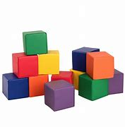
We aim to support children’s learning by:
Building the children’s confidence as learners.
Building on what the children already know.
Using rapid intervention to address misconceptions.

Slide 5

Timings for the school day
School starts at 8:45am and finishes at 3.15
Time | Activity
8.40 | Doors Open
8.45 | Register
8.50 | Morning Activities (Phonics, Guided reading, Spellings Handwriting, )
9.30 | English
10.30 | Times tables
10.45 | Assembly
11.00 | Break
11.15 | Maths
12.15 | Lunch
1.15 | Foundation Subjects
3.10 | Story
3.15 | School finishes
Doors open
First lesson (English or Maths)
Whole School Collective Worship
Playtime
Second lesson (English or Maths)
Lunch and Playtime
Foundation Subjects
End of the school day
Children will be collected from the playground at 3.15 pm

Slide 6


Maths
Lessons will be held each morning together with Teaching Assistants to support the children’s learning. Daily times tables sessions to ensure fluency.
Key aims:
Fluency, Reasoning, Problem Solving.
Times tables knowledge essential.
Please see the Maths Expectations sheet for you to take home.

Slide 7

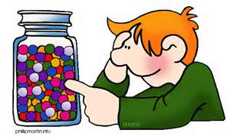




Number and Place Value
Count in 4s, 8s, 50s and 100s from any number
Read and write numbers up to 1000 in numbers and words
Compare and order numbers up to 1000
Recognise the place value of each digit in three-digit numbers (hundreds, tens and ones)
Find ten more or ten less than a given number
Identify, estimate and represent numbers in different ways
Solve number problems and practical problems that involve all of the above
Calculation
Addition and Subtraction
Add and subtract numbers mentally including a three digit number and ones, a three digit number and tens, a three digit number and hundreds
Add and subtract numbers with up to three-digits using an efficient written method
Estimate the answers to a calculation and use the inverse to check answers
Solve missing number problems using number facts, place value, and more complex addition and subtraction
Multiplication and Division
Recall and use multiplication and division facts for the 3, 4, and 8 multiplication tables
Multiply and divide numbers mentally and using an efficient written method (up to TU x U and TU ÷ U)
Solve problems, including missing number problems, involving multiplication and division, including scaling problems
Year 3
End of year expectations
Fractions
Count up and down in tenths
Understand what tenths mean
Recognise, find and write fractions of a set of objects e.g. ¼ of 12 pencils or ¾ of 20 shells
Recognise and show, using diagrams, equivalent fractions
Compare and order fractions with the same denominator
Add and subtract fractions with the same denominator within one whole e.g. 5/7 + 1/7 = 6/7
Solve problems that involve all of the above
Measurement
Compare and measure: lengths (mm. cm. m), masses (g,kg), volumes/capacities (ml,l)
Estimate, tell and write the time on an analogue clock to the nearest minute (12 and 24 hour)
Know and use facts about time e.g. 60 minutes in an hour, 365 days in a year/366 in a leap year and vocabulary about time e.g. am/pm
Compare time in terms of seconds, minutes and hours using vocabulary such as o’clock, am/pm, morning, afternoon, noon and midnight
Calculate durations of time for example to calculate the time taken between particular events
Measure the perimeter of simple 2-D shapes
Add and subtract amounts of money, using both pounds and pence (including giving change)
Add and subtract in the context of length, mass and capacity/volume
Geometry
Identify horizontal, vertical, perpendicular an parallel lines in shapes
Draw 2-D shapes using given dimensions and angles
Make and describe 3-D shapes
Recognise angles within a shape as a right angle, less than a right angle or greater than a right angle and as an angle of turn
Statistics
Solve one-step and two-step questions (e.g. ‘How many more?’ and ‘How many fewer?’) using information presented in scaled bar charts, pictograms and tables
Notes:
Example of what could be posted by each year group on their website. This is taken from new end of year objective sheets, They will be able to get decent clipart to add!

Slide 8



English
Lessons will be held each morning together with Teaching Assistants to support the children’s learning.
We teach a range of fiction, non-fiction, and poetry units.
Some of the books we study include; Aesop's Fables, The Twits, The Firework Maker's Daughter, and The Boy Who Grew Dragons.
Please see the English Expectations sheet for you to take home.

Slide 9
We will complete the phonics scheme during the first half-term in September.
After the October half-term, phonics will be replaced with guided reading sessions.

Slide 10
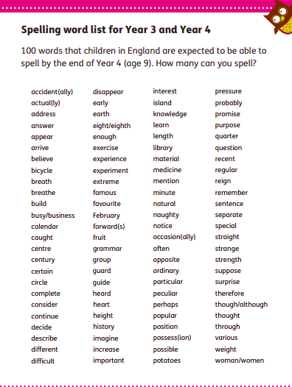
KS2 Spelling
Year 3 and 4
statutory spelling list
Please see the spelling sheet for you to take home.

Slide 11

Year 3 Curriculum
Science: Animals including humans, Forces and magnets, Rocks, Light, Plants
R.E: What’s the bible’s ‘big story ’and -why is it like treasure for Christians.
How can artists help us to understand what Christians believe and do? Judaism: What are important times for Jewish people?
How did Jesus change lives- and how is it ’good news?’
Sikism: What do Sikhs value?
How do people use creative ways to express their beliefs?

Slide 12
History:
The Stone Age,
The Bronze and Iron age,
Early civilisations –The Egyptians.
Geography:
Field work-How can we put Staines on the map? Our country- region of the UK Dorset
Other subjects will be linked to our topics where appropriate.
Art, Music, P.E, DT, Computing, PSHE, French.

Slide 13
Class Trips/Workshops
(to be confirmed)
Stone Age to the Iron Age in-school workshop, led by Chertsey Museum (end of September)
Rocks and Fossils in-school workshop, led by Haslemere Museum (January)
Egyptian workshop at Haslemere Museum (May)

Slide 14


PE and Games
PE will be on a Tuesday with a PE coach and Monday or Wednesday afternoon with Mrs Ambridge.(TBC)
Children come to school ready for P.E. Please ensure they are equipped with the P.E. uniform and appropriate footwear. The school PE Kit includes blue polo shirts, shorts for gym and joggers for outside in cooler weather.
No earrings or watches please on PE days.
Games, Gym and Dance (Athletics and Swimming in Summer )

Slide 15

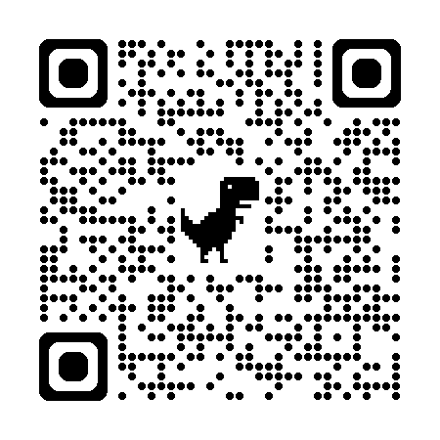
Home Learning
Reading
Please listen to your child read aloud every day and initial in their home school link book.
We aim to Benchmark each half-term.
We continue up to Ruby level in Year 3.
Children will become wider readers if they pass Ruby level.
Library books will be changed weekly (day to be decided)
Please can you encourage your children to read for pleasure at home and continue reading aloud to them at bedtimes or other convenient times. A recommended reading list for year 3 is available here: https://www.booksfortopics.com/booklists/recommended-reads/year-3/

Slide 16

Home Learning
English – Phonics/spellings to practice via Spelling Shed weekly.
Maths – Quizzes and activities via Maths Shed to consolidate class learning weekly
Times tables – these will be sent home as we progress through the year (Number Sense scheme)
Topic – Half termly or termly topic grid
White Rose 1 minute Maths app is also very helpful for improving fluency.

Slide 17
Expectations for learning and behaviour in Year 3
Children will develop their independent learning skills.
Children will be expected to focus on their learning and to take pride in their work both in content and presentation.

Slide 18

Rewards/Sanctions
Praise and encouragement
Marble Jar- work towards class rewards ie golden time
Team points
Sanctions- warning, yellow and red card system, for use on both the playground and classroom.
(warning, then a yellow card then a second yellow card= lose 5 minutes of playtime. This is reset at lunchtime. Red cards can be given straight or after WYY)

Slide 19
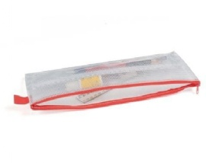

What do the children need
KS2 Pencil case- must be see through and small.
Children in KS2 (Y3-Y6) need to bring their own pencil case to school, however please can we ask that these are see through small and only contain the necessary items. Large pencil cases are hard to store in the children’s trays and expensive, unnecessary stationery can easily get lost.
All children need the following
HB pencil and a spare
Blue fibre tip handwriting pen
Small selection of colouring pencils
Whiteboard pen
Small children’s scissors
15com ruler
Eraser
Small pencil sharpener
Not needed
Felt tip pens
Sharpie pens
Gel pens
Ink erasers
Compass/set square
Any novelty items, please no erasers, pens, pencils that could cause a distraction

Slide 20
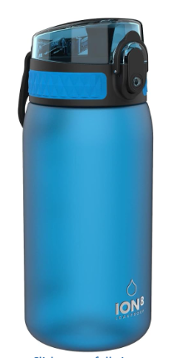
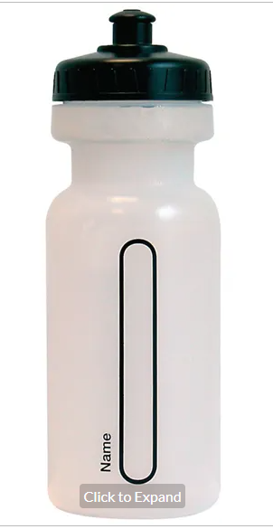
Water bottles & Snack
Only water bottles with sports cap to avoid spills
No novelty water bottles
Maximum size 750ml (to be refilled when empty)
Only water in the bottles please
Snack;
  Fresh fruit, vegetables, plain bread sticks and/or crackers
  No snacks containing high sugar, salt or fat ie fruit winders etc

Slide 21
How can you help?
  It is important that we have a fair and consistent approach to our school rules therefore please support us by following our requests.
  It is particularly important for you to ensure your child is following our school behaviour policy, especially if we ask for your support at home. Also, that they have the correct:
  Footwear & uniform (including PE uniform)
  Clear Pencil cases with required contents
  Water bottle with pop lid to avoid spills
  No high sugar or salt snacks

Slide 22
Other Business
Uniform – Shirt and Tie or polo shirts. All uniform including PE Kit must be clearly labelled.
Clubs - To be confirmed in the new term. Earlybirds will run from 7.30am and Owls club from 3 – 5.30pm.
Finally!
Please feel free to discuss any aspect of your child’s learning with us. Working together we can make the transition as smooth as possible.

Slide 23

Any questions?

Slide 24

Thank you!
We look forward to working with you and your children this year!
Mrs Ambridge and Mrs Tambaro

