Slide 1
Meet the team
Topaz Class
Year 6 – 2025/26

Slide 2
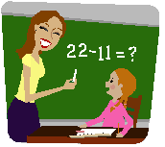
The Topaz Class Team
Class teacher: Miss Goodson
Mrs Sims
Mrs McLaren
Mrs Rookes

Slide 3
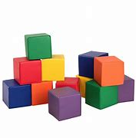
In September we aim to support children’s learning by:
Building the children’s confidence as learners.
Building on what the children already know.
Using rapid intervention to address misconceptions.

Slide 4

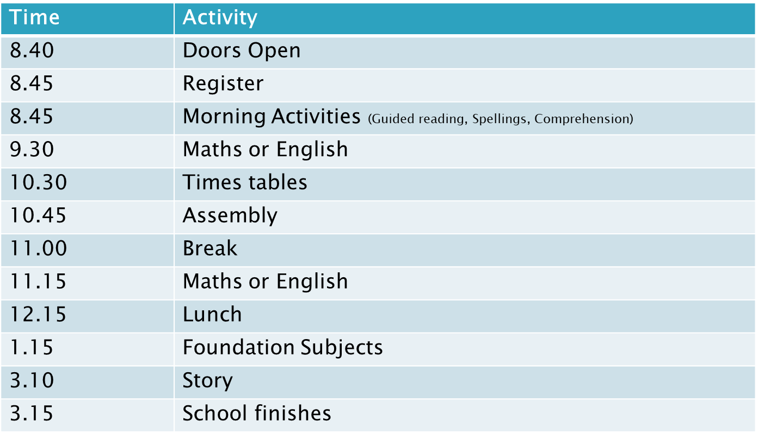
Timings for the school day
School starts at 8:45am.
The register will close at 9am.

Slide 5

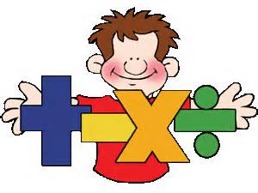

Maths
Lessons will be held each morning together with Teaching Assistants to support the children’s learning.
Key aims:
Fluency, Reasoning, Problem Solving.
Pre – teaching intervention
SATs paper: 1 Arithmetic and 2 reasoning papers.

Slide 6
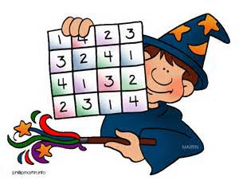
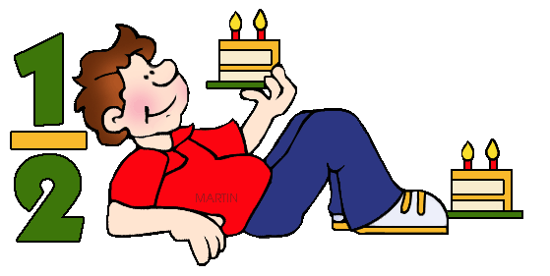

Number and Place Value
Read, write, order and compare numbers up to 10,000,000 and determine the value of each digit
Round any whole number to a required degree of accuracy
Use negative numbers in context e.g. temperature, and calculate intervals across 0
Solve number and practical problems that involve all of the above
Calculation
Addition, subtraction, multiplication and division
Multiply multi-digit numbers up to 4 digits by a two-digit whole number using the formal written method of long multiplication
Divide numbers up to 4 digits by a two-digit whole number using the formal written method of long division, and interpret remainders as whole number remainders, fractions, or by rounding, as appropriate for the context
Divide numbers up to 4 digits by a two-digit number using the formal written method of short division where appropriate, interpreting remainders according to the context
Perform mental calculations, including with mixed operations and large numbers
identify common factors, common multiples and prime numbers
Use knowledge of the order of operations to carry out calculations involving the 4 operations
Solve addition and subtraction multi-step problems in contexts, deciding which operations and methods to use and why
Solve problems involving addition, subtraction, multiplication and division
Use estimation to check answers to calculations and determine, in the context of a problem, an appropriate degree of accuracy
Fractions (including decimals and percentages)
Use common factors to simplify fractions; use common multiples to express fractions in the same denomination
Compare and order fractions, including fractions >1
Add and subtract fractions with different denominators and mixed numbers, using the concept of equivalent fractions
Multiply simple pairs of proper fractions, writing the answer in its simplest form [for example, 1/4 × 1/2 = 1/8]
Divide proper fractions by whole numbers [for example, 1/3 ÷ 2 =1/6]
associate a fraction with division and calculate decimal fraction equivalents [for example, 0.375] for a simple fraction [for example, 3/8]
Identify the value of each digit in numbers given to 3 decimal places and multiply and divide numbers by 10, 100 and 1,000 giving answers up to 3 decimal places
Multiply one-digit numbers with up to 2 decimal places by whole numbers
Use written division methods in cases where the answer has up to 2 decimal places
Solve problems which require answers to be rounded to specified degrees of accuracy
Recall and use equivalences between simple fractions, decimals and percentages, including in different contexts
Ratio and Proportion
Solve problems involving the relative sizes of 2 quantities where missing values can be found by using integer multiplication and division facts
Solve problems involving the calculation of percentages [for example, of measures and such as 15% of 360] and the use of percentages for comparison
Solve problems involving similar shapes where the scale factor is known or can be found
Solve problems involving unequal sharing and grouping using knowledge of fractions and multiples
Year 6
End of year expectations
Notes:
Example of what could be posted by each year group on their website. This is taken from new end of year objective sheets, They will be able to get decent clipart to add!

Slide 7

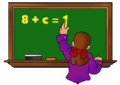

Geometry
Draw 2-D shapes using given dimensions and angles
Recognise, describe and build simple 3-D shapes, including making nets
Compare and classify geometric shapes based on their properties and sizes and find unknown angles in any triangles, quadrilaterals, and regular polygons
Illustrate and name parts of circles, including radius, diameter and circumference and know that the diameter is twice the radius
Recognise angles where they meet at a point, are on a straight line, or are vertically opposite, and find missing angles
Describe positions on the full coordinate grid (all 4 quadrants)
Draw and translate simple shapes on the coordinate plane, and reflect them in the axes
Year 6
End of year expectations
Measurement
Solve problems involving the calculation and conversion of units of measure, using decimal notation up to 3 decimal places where appropriate
Use, read, write and convert between standard units, converting measurements of length, mass, volume and time from a smaller unit of measure to a larger unit, and vice versa, using decimal notation to up to 3 decimal places
Convert between miles and kilometres
Recognise that shapes with the same areas can have different perimeters and vice versa
Recognise when it is possible to use formulae for area and volume of shapes
Calculate the area of parallelograms and triangles
Calculate, estimate and compare volume of cubes and cuboids using standard units, including cubic centimetres (cm³) and cubic metres (m³), and extending to
other units [for example, mm³ and km³]
Algebra
Use simple formulae e.g. l x w (length x width) to find area
Generate and describe linear number sequences
Express missing number problems algebraically
Find pairs of numbers that satisfy an equation with 2 unknowns
Enumerate possibilities of combinations of 2 variables
Statistics
Interpret and construct pie charts and line graphs and use these to solve problems
Calculate and interpret the mean as an average
Notes:
Example of what could be posted by each year group on their website. This is taken from new end of year objective sheets, They will be able to get decent clipart to add!

Slide 8


Counting and Understanding Numbers/Knowing and Using Number Facts
Find the difference between a positive and negative integer,
or two negative integers, in context.
Use decimal notation for tenths, hundredths and thousandths,
and partition and order them.
Round decimals.
Reduce a fraction to its simplest form by cancelling common factors 6/12 = ½
Order fractions by converting them to fractions with common denominators
Solve simple problems involving ratio and proportion.
Find equivalent decimals, fractions and percentages.
Use my knowledge of multiplication tables to 10 x 10 to work out related facts involving decimals e.g. 0.8 x 7, 4.8 ÷ 6.
Work out square numbers to 12 x 12
Know what a prime number is and can identify prime numbers less than 100
Using and Applying Mathematics
Solve multi-step problems, and problems involving fractions, decimals and percentages, choosing and using appropriate and efficient methods at each stage
Explain a problem has been solved and check to see whether the answer is reasonable.
Solve problems where symbols are used to indicate unknown quantities.
Understanding Shape
Make and draw shapes with increasing accuracy.
Confidently name 2-D shapes and 3-D solids and discuss their properties.
Use co-ordinates.
Use a protractor to estimate, measure and draw angles, on their own and inside shapes.
Measuring
Use standard metric units of measure and convert between units.
Measure and calculate imperial units still in everyday use.
Know approximate imperial and metric measurements.
Read scales accurately and record results.
Work out the area and the perimeter of rectilinear shapes (L shapes)
Estimate the area of an irregular shape by counting squares.
Calculating
Calculate mentally with whole numbers and decimals e.g. U.t +/- U.t, TU x U,
U.t x U, HTU ÷ U, U.t ÷ U.
Use a written method to add, subtract, multiply and divide integers and decimal numbers; calculate the answer to HTU ÷ U and U.t ÷ U to one or two decimal places.
Find fractions and percentages of whole-number quantities
Carry out calculations involving time by converting hours and minutes to minutes.
Handling Data
Describe and predict outcomes from data using the language of
chance or likelihood.
Solve a problem by drawing a graph, chart or table and read and
understand the information it displays including pie charts.
Use the mode, range, median and mean.
Year 6 Key Learning Objectives
Old Curriculum

Slide 9



English
Lessons will be held each morning together with Teaching Assistants to support the children’s learning.
Range of Fiction, Non-Fiction and Poetry Writing and Reading.
Importance of Spelling, Punctuation, Grammar.
SATs paper: Grammar Paper and spelling paper and Reading paper

Slide 10
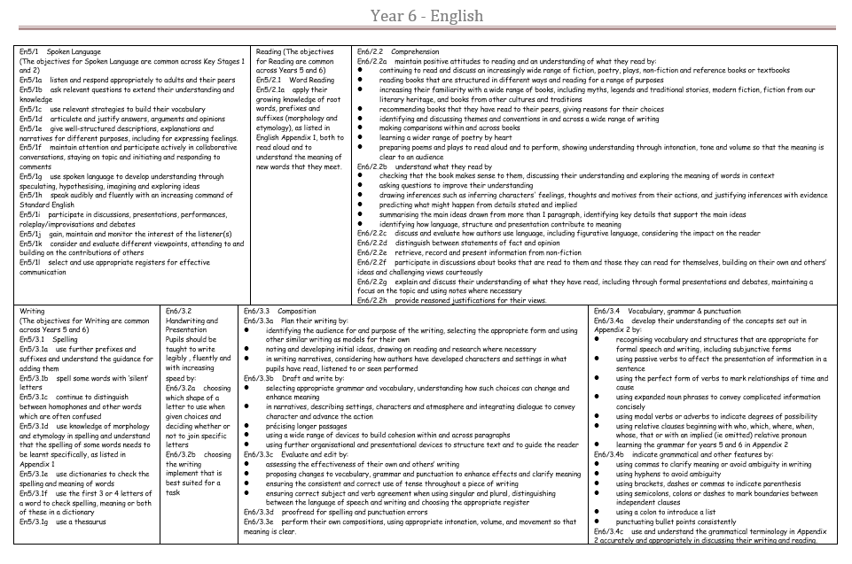

Slide 11
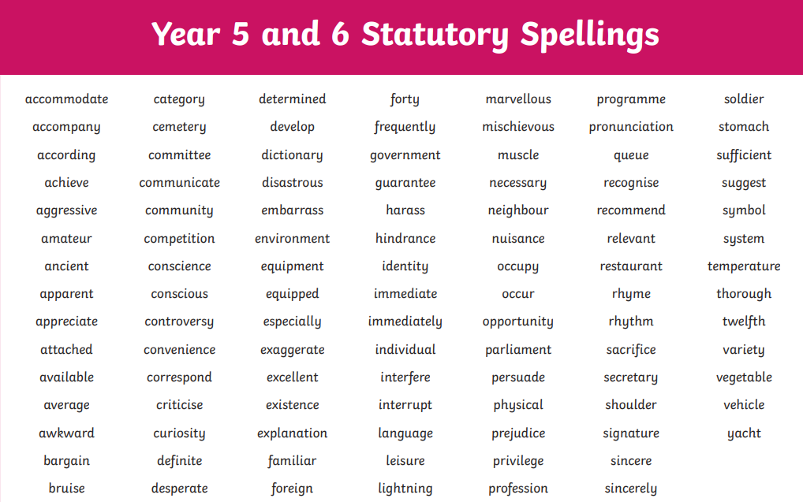
KS 2 Spelling

Slide 12

Year 6 Curriculum
Our Topics:
History: WW1 and WW2, Ancient Greeks
Geography: How Green is Surrey? World studies
Science: Living things and their habitat, The circulatory system, Electricity, Light, Evolution
R.E: Christianity (3 units) Buddhism, Islam and Who am I and where do I belong? (Theme unit)
Other subjects will be linked to our topics where appropriate. Art, Music, P.E, DT, Computing, PSHE, RSE, French.
Class Trips – Y6 residential, Church visit, workshops

Slide 13
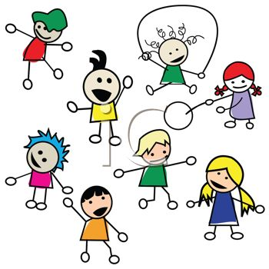

PE and Games
PE: 1 session with Sport coach and 1 session with the class teacher.
Summer term: Swimming replaces lesson with teacher
Please ensure children have the correct PE kit and make sure they are labelled especially jumpers.
No jewellery during PE lessons.

Slide 14

Home Learning
Reading
Please listen to your child read aloud every day and initial in their homework diary.
The children will need to read a selection of genres on each level and complete comprehension questions before they can move on. We continue up to Wider reader in Year 6
We aim to Benchmark each term to see if the children are able to move up.
New books will be sent home to match the current book band and a library book of their choice

Slide 15
Home Learning
Reading at home
Here is a link to a suggested reading list for Year 6 children which you may find helpful when choosing other books to read at home.
https://schoolreadinglist.co.uk/reading-lists-for-ks2-school-pupils/suggested-reading-list-for-year-6-pupils-ks2-age-10-11/

Slide 16
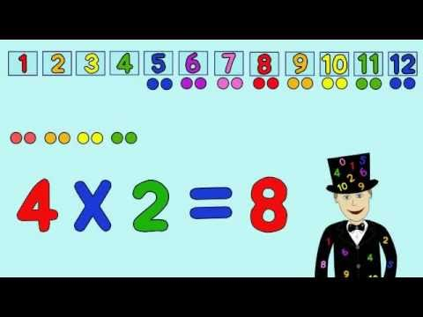
Home Learning
English – Spelling Shed
Maths – White rose booklet to consolidate class learning or arithmetic practise.
Topic – Half termly or termly topic grid

Slide 17
Expectations for learning and behaviour in Year 6
Independent learners – taking ownership over their learning and what they need
Children will be expected to maintain focus on their learning and to take pride in their work both in content and presentation.
In year 6, the children will be expected to be acting as positive role models for the younger children in the school – walking in and around school, assemblies and so on. Respect.
Secondary ready!

Slide 18

Rewards
Whole class reward system – marble in a jar
Team Points
Praise

Slide 19
REMINDERS
Uniform – Shirt and Tie or polo shirts. All uniform including PE Kit must be clearly labelled.
Clubs - To be confirmed in the new year. Earlybirds will run from 7.30am and Owls club from 3.15 – 6pm.
Please be mindful when buying items for school that the cloakrooms are in the corridor and space is at a premium!

Slide 20
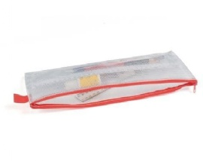

KS2 Pencil Case – must be see through and small
Children in KS2 (Y3 to Y6) need to bring their own pencil case to school, however please can we ask that these are see through small and only contain the necessary items. Large pencil cases are hard to store in the children’s trays and expensive, unnecessary stationery can easily get lost.
All children need the following:
HB pencil (and spare)
Blue fibre tip handwriting pen
Small selection of colouring pencils
Whiteboard pen
Small children’s scissors
Pritt Stick
15cm ruler
Eraser
Small pencil sharpener
Not needed:
Felt tip pens
Sharpie pens
Gel pens
Ink eraser
Compass / set square
Any novelty item; please no erasers, pencil sharpeners, pens, pencils that could cause a distraction

Slide 21
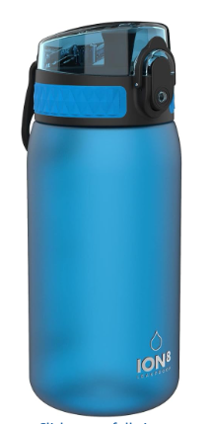
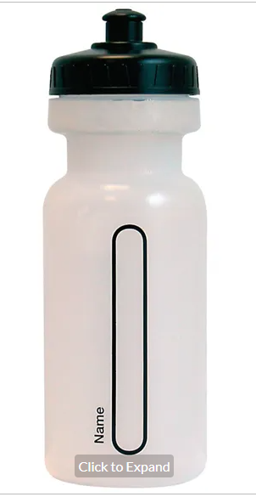
Water bottles & Snack
Only water bottles with sports cap to avoid spills
No novelty water bottles
Maximum size 750ml (to be refilled when empty)
Only water in the bottles please
Snack;
  Fresh fruit, vegetables, plain bread sticks and/or crackers
  No snacks containing high sugar, salt or fat ie fruit winders etc

Slide 22
How can you help?
  It is important that we have a fair and consistent approach to our school rules therefore please support us by following our requests.
  It is particularly important for you to ensure your child is following our school behaviour policy, especially if we ask for your support at home. Also, that they have the correct:
  Footwear & uniform (including PE uniform)
  Clear Pencil cases with required contents
  Water bottle with pop lid to avoid spills
  No high sugar or salt snacks
Notes:
Support your child with Home learning activities; especially reading & times tables…
Attend FOTSA events and support with getting events ready… so important for the extra things we are able to offer our children; Opal Play, Swimming, trips and events to name a few
Come along to parent Voice meetings and help others to express their worries, concerns, share things they are happy with, offer solutions for things we can fix.
Consider coming along to help in your child’s class – please note that you will need to have a safeguarding talk with me before helping in school.
Share your worries with us and we will do our best to make things better. No worry is too small.
Offer your congratulations when things go well. It is always so lovely to receive an email or card from parents and children when they are really happy with something.

Slide 23

Any questions?

