Slide 1



Welcome
To
Meet the Team
2025
Notes:
My name is Joe Blaney, I am your new Headteacher.
Our door is always always open! No question is too small. Please come and find us if you would like to share something or you have a suggestion.
We put great emphasis on our partnership with parents to reinforce our vision that every child flourishes. Your support is invaluable.
With this in mind – we’d like to ask for your help…
/// We teach our children to accept when they don’t win and encourage them to lose with good grace
/// We teach our children to accept responsibility for their actions
/// We teach them to accept it when we say no to them.
If we can all nurture resilience to lose with grace, /// learn from mistakes and quickly move on and /// comply when they are denied something /// it would reduce our collective daily challenges.
So, to the TEAM - this is one of my favourite evenings when I get the opportunity to say a very big cheesey thank you to our dedicated volunteers and staff for their unwavering support this year // we are so lucky to have a very talented group of people, with lots and lots of experience to call upon – I ask you to give our team a very hearty round of applause…
Thank you!
And so to our wonderful teams;

Slide 2



the Senior Leadership Team 2025-2026
Joe Blaney – Headteacher DSL
Carly Orriss – AHT, SENCO & DDSL
Naomi Warren – AHT, English Specialist
Mandy Ambridge – Maths Specialist
Lisa Wallage – RE Specialist
Susan Holmes – SBM and Governor
Notes:
I’m going to race through a lot of names now of the people who either work at Thorpe or volunteer at Thorpe so that your children get the very best opportunity they can.
You will get to know these people as you travel through the school.
Please could all members of our senior leadership team stand up.

Slide 3


the Governors
Linda Gillham – Co-Chair (Local Authority)
Andy West(Foundation) Co-Chair
Stephen Girling– Vice Chair (Ex Officio), Vicar at St Mary’s
Joe Blaney – Headteacher (Ex Officio)
Stuart Bainbridge – Chair of Finance and Staffing Committee(Parent Governor)
Bryan Nixon – Chair of Physical Environment Committee(Foundation Governor)
Andrea Stirling – Williams Chair of Children’s Learning (Foundation)
Susan Holmes – SBM Link Governor (Co-opted)
TBC(Staff Governor)
Margaret Harnden (Foundation)
Margaret Roberts (Foundation)
Vacancy(Foundation)
Harriet Turk- (Parent Governor)
Notes:
I’d like to introduce some of our Governors… Linda Gillham on behalf of the Governing Body.
We have a strong Governing Body who work very hard for every child in the school. Our Governors come from a variety of back grounds and give their time on a voluntary basis to enhance the provision and opportunities for your children. They hold the senior leadership to account and offer support as a critical friend. We are very lucky to have such an amazing governing body.

Slide 4
the Governors & the Vicar
A welcome from Linda Gilham & Andy West Chair of Governors
A welcome from Fr Stephen, Vicar at St Mary’s Church

Slide 5


Whole School Support
Mrs Wright - Office Administrator
Mrs Tiller – Office Administrator
Mrs Fountain – School Secretary
Mrs Holmes – School Business Manager
Mr Lubbock – Site Manager

Slide 6
Whole School Support
ELSA, DDSL, SALT Mrs McLaren
Earlybirds Mrs Chamberlain, Mrs Mellor, Mrs Elmer, Mrs McLaren, Mrs Sims
Owl Club Managers Mrs Sevier DDSL & Mrs Sims DDSL
Sports’ Coach Mr Orriss

Slide 7


the Sapphire Teaching Team (YR)
Sapphire Class Year R
CTs Mrs Wallage (M, W-F) Mrs Metla (T) ~
Team Mrs Herbert(M-W) Mrs Parsons (Th, F)

Slide 8
the Emerald Teaching Team (Y1)
Emerald Class Year 1
CT Mrs Maher M, T, W Miss Warren Th, F
Team Mrs Wade & Mrs Elmer

Slide 9
the Ruby Teaching Team (Y2)
Ruby Class Year 2
CTs Mrs George (M-W) & Mrs Graham (W-F) ~ Team Mrs Mellor & Mrs Wade, Mrs Sevier & Mrs Chamberlain & Mrs James

Slide 10
the Amethyst Teaching Team (Y3)
Amethyst Class Year 3
CTs Mrs Ambridge (M-W) Mrs Tambaro(Th, F)
Team Mrs Ives & Mrs McGranaghan

Slide 11
the Garnet Teaching Team (Y4)
Garnet Class Year 4
CT Mrs Vassallo
Team Mrs Lucas & Mrs Williams

Slide 12
the Amber Teaching Team (Y5)
Amber Class Year 5
CT Mrs Whenham
Team Mrs Rookes & Mrs Williams

Slide 13
the Topaz Teaching Team (Y6)
Topaz Class Year 6
Interviewing for Class Teacher
Team Mrs Sims, Mrs Rookes, Mrs McLaren

Slide 14



School Trips & Enrichment
Residential Trips, Farm visits,
Inspirational visitors
Enrichment days,
Y6 production…
Assemblies & Church visits
Notes:
We take the children in Year 5 & 6 on a Residential Trip to High Ashurst,
Our Class trips include: Kensington Palace, Guildford Cathedral, Windsor Castle, Bockett’s Farm, Haslemere Museum, Victorian School & Henley Fort
We have had inspirational visitors including athletes, firemen, nurses and hope to welcome them back next academic year.
We aim to offer our children enrichment days; Roman, Greek, Victorian, African, Y6 production

Slide 15
Parent Voice
Termly meetings with the Headteacher
  If you’d like to join us for the next meeting it will be on
  Friday 19th September at 9.30 via TEAMS
  Please come along if you’d like to know more!
Notes:
These meetings have been successful for us to make sure communication between parents and staff is good… if you would like to know more, please come along to our next meeting on Friday 20th September.
They really do have an impact on what we do in school.

Slide 16

FOTSA
Termly meetings
  If you’d like to join us for the next meeting it will be on
  Thursday 9th October at 8pm School Hall and Online
  Please come along if you’d like to know more as we do have vacancies.
Notes:
These meetings have been successful for us to make sure communication between parents and staff is good… if you would like to know more, please come along to our next meeting on Friday 22nd September.
They really do have an impact on what we do in school.
Our Friends Association FOTSA is a huge part of our school and even more important in this current economic climate. FOTSA is now a charity, which is amazing and will hopefully open financial doors that were closed to us before regarding bids and funding.
Every parent is automatically a member of FOTSA and encouraged to attend meetings have your say and make a difference to raise money for the children at our school. This year we have been lucky enough to have money from FOTSA
to fund resources for the children in each class. £200 per class
Maintaining Sand pit
Laptops and trolley £3500
Typical FOTSA events are:
Summer Events
Winter Events
Disco Events
Cake Sales
Ice-cream sales
Cinema Events
Parent Evening Events
Refreshments at School Events
Second hand uniform sales

Slide 17

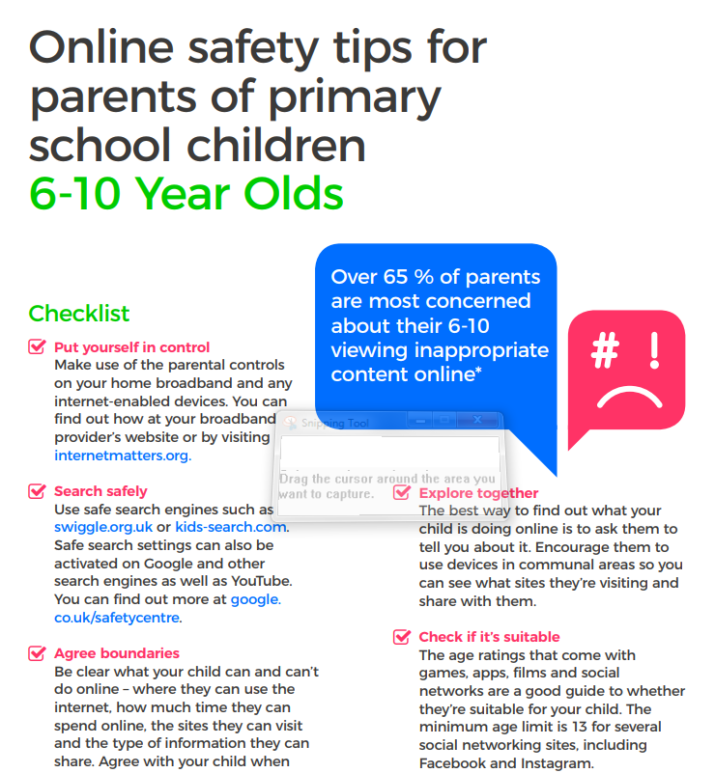
Keep up with children on the internet
https://www.internetmatters.org/resources/online-safety-guide-0-5-year-olds/
https://www.internetmatters.org/resources/online-safety-guide-6-10-year-olds
Notes:
We have printed off some leaflets for you. They are aimed at slightly older children but a lot of children have tablets and access to computers so we were advised to give these out so you can take or leave what is relevant to your child.

Slide 18
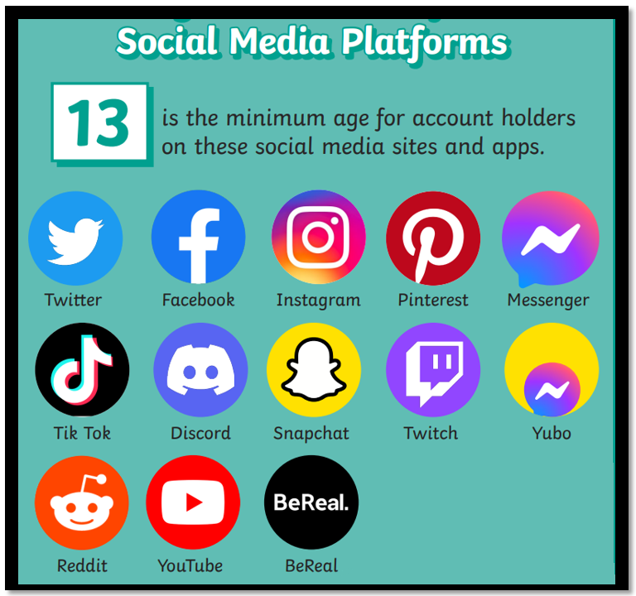
Keep up with children on the internet
Notes:
Please do not allow your children to have apps or games beyond their years. We have had SO much trouble with children misinterpreting their peers on apps like WhatsApp and leads to heart ache and trauma. Their development is not ready for the content of many of these apps and they get too much stimulation/sensory feedback. Please please know what your children are doing and limit/ban the use of electronics.

Slide 19

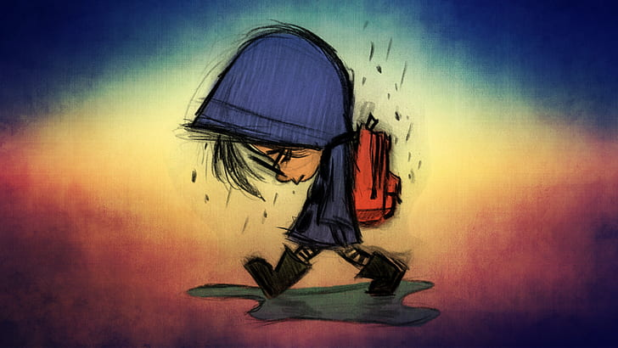
Behaviour
Notes:
The majority of behaviour at Thorpe is amazing and we want your children to bounce into school and want to be here. Sometimes, poor behaviour can stop that from happening. The majority of parents are 100% on board with supporting school if we report an issue,
but occasionally we have parents and carers that will choose to enable their children’s poor behaviour. That very small minority can have a big impact and can be very damaging to everyone involved.
No child wants to be out of control, children like to follow the rules and know where they are and be praised for it… if they are getting different messages at home to school, this make everything very confusing for them. If we call you to say that we need support with your child, please believe us and support your child at home with sanctions. If we work together we can work wonders.
We use a yellow and red card system to support children at our school. Warning, then yellow, then red if they’ve had two yellow.
We use emotion coaching language and Zones of regulation to allow children to express how they are feeling.

Slide 20
Safeguarding
We take this very seriously at Thorpe.
Everyone who comes into contact with our children will have had regular safeguarding training and be screened using the Disclosure and Barring Service.
We are all diligent in recording any worries we have and refer for support or advice when needed.
We work closely with parents regarding any issues and support or signpost.
All staff are up to date with the following training; First Aid, Prevent, GDPR ,Fire safety training & Safeguarding… as well as training specific to their roles.
Notes:
We take this very seriously at Thorpe.
Everyone who comes into contact with our children will have had regular safeguarding training and be screened using the Disclosure and Barring Service.
We are all diligent in recording any worries we have and refer for support or advice when needed.
We work closely with parents regarding any issues and support or signpost.

Slide 21
How can you help?
  It is important that we have a fair and consistent approach to our school rules therefore please support us by following our requests.
  It is particularly important for you to ensure your child is following our school behaviour policy and also that they have the correct:
  Footwear & uniform (including PE uniform)
  Clear Pencil cases with required contents
  Water bottle with pop lid to avoid spills
  No high sugar or salt snacks
*Please note that incorrect kit will be kept by class teacher or office for collection by parents.
Notes:
Your child’s class teacher will speak more about this and go through uniform and behaviour expectations.

Slide 22
How can you help? Take 2
Support your child with Home learning activities; especially reading & times tables.
Attend FOTSA events.
Join Parent Voice & Fotsa
Consider helping in your child’s class.
Share any worries or Concerns.
Celebrate ~ focus on what went well at school…
Notes:
Support your child with Home learning activities; especially reading & times tables…
Attend FOTSA events and support with getting events ready… so important for the extra things we are able to offer our children; Opal Play, Swimming, trips and events to name a few
Come along to parent Voice meetings and help others to express their worries, concerns, share things they are happy with, offer solutions for things we can fix.
Consider coming along to help in your child’s class – please note that you will need to have a safeguarding talk with me before helping in school.
Share your worries with us and we will do our best to make things better. No worry is too small.
Offer your congratulations when things go well. It is always so lovely to receive an email or card from parents and children when they are really happy with something.

Slide 23

Off to classes…
Thank you!
Notes:
Class teachers to lead their parents out of the hall.

